Slide 1
Chapter 13 Stream Input/Output
C++ How to Program, 9/e

Slide 2
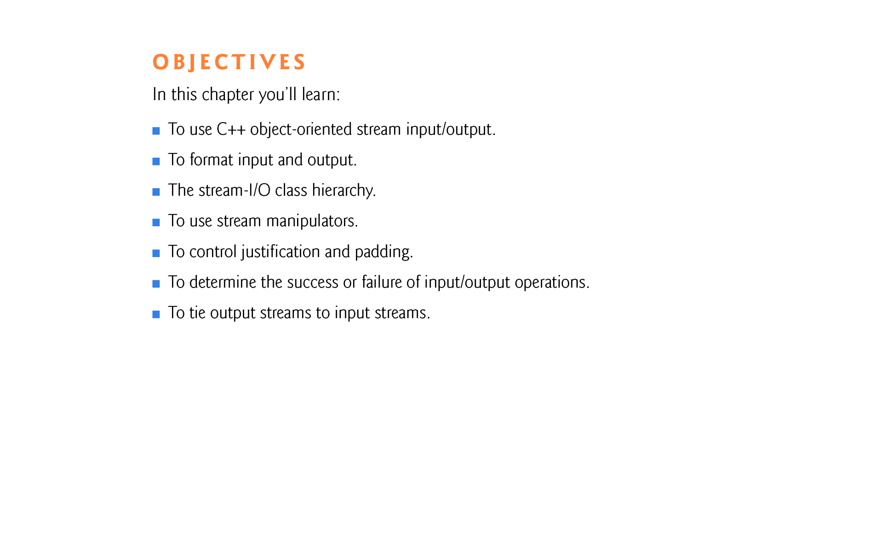

Slide 3
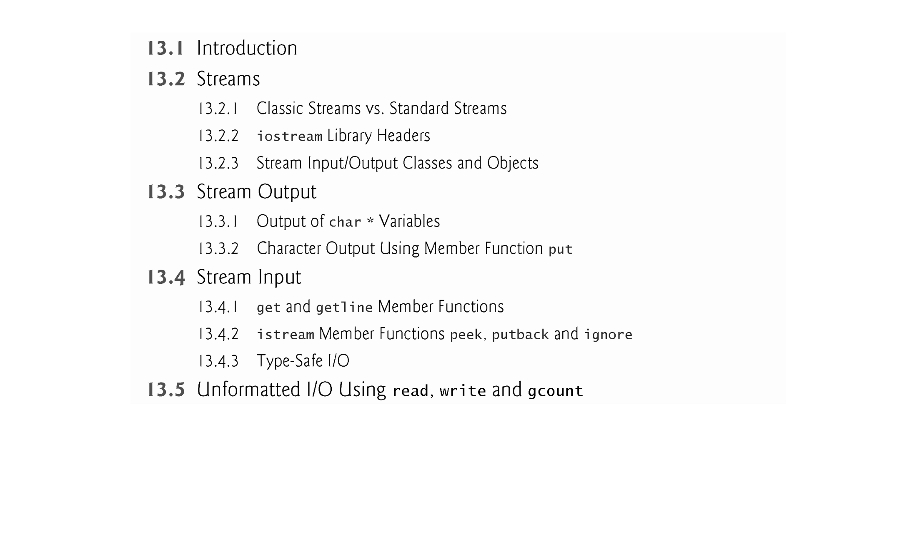

Slide 4
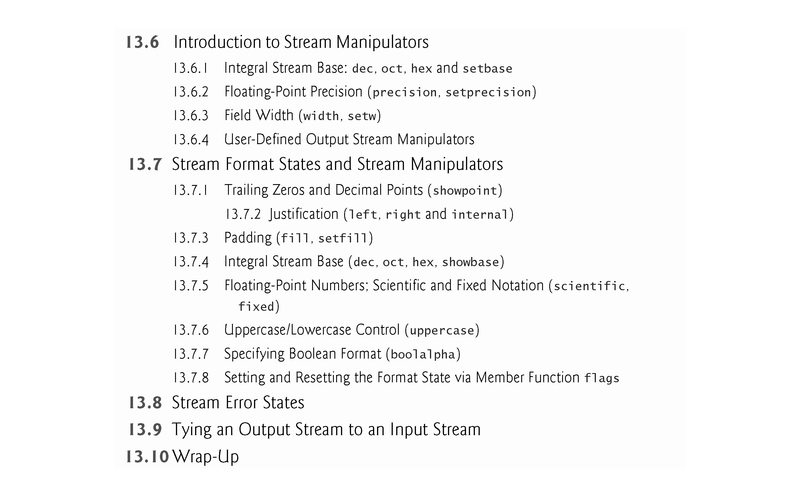

Slide 5
13.1 Introduction
C++ uses type-safe I/O.
Each I/O operation is executed in a manner sensitive to the data type.
If an I/O function has been defined to handle a particular data type, then that member function is called to handle that data type.
If there is no match between the type of the actual data and a function for handling that data type, the compiler generates an error.
Thus, improper data cannot “sneak” through the system.
Users can specify how to perform I/O for objects of user-defined types by overloading the stream insertion operator (<<) and the stream extraction operator (>>).

Slide 6
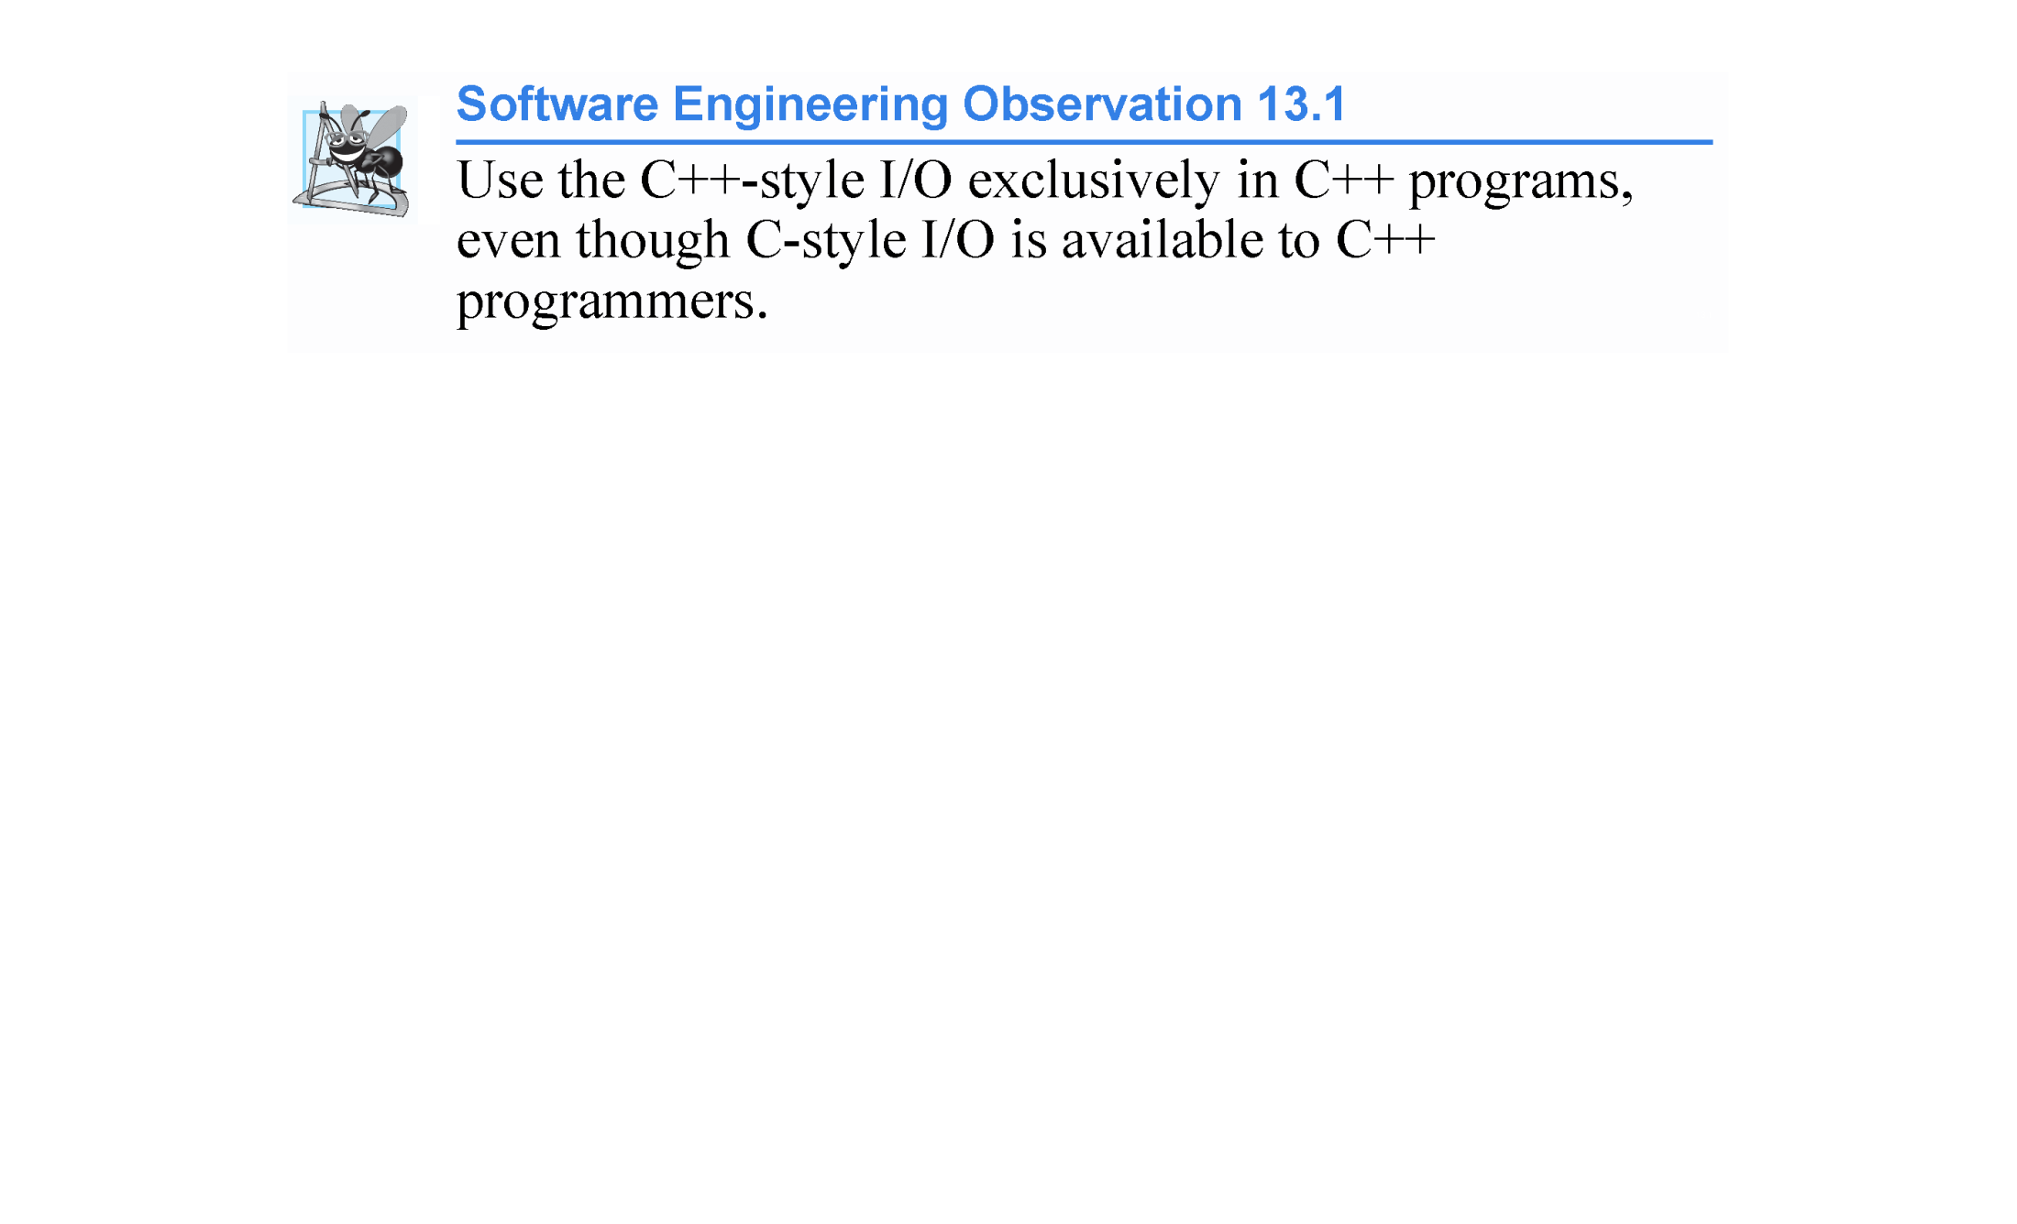
Language
C++ C
Input: cin scanf( )
Output: cout printf( )

Slide 7
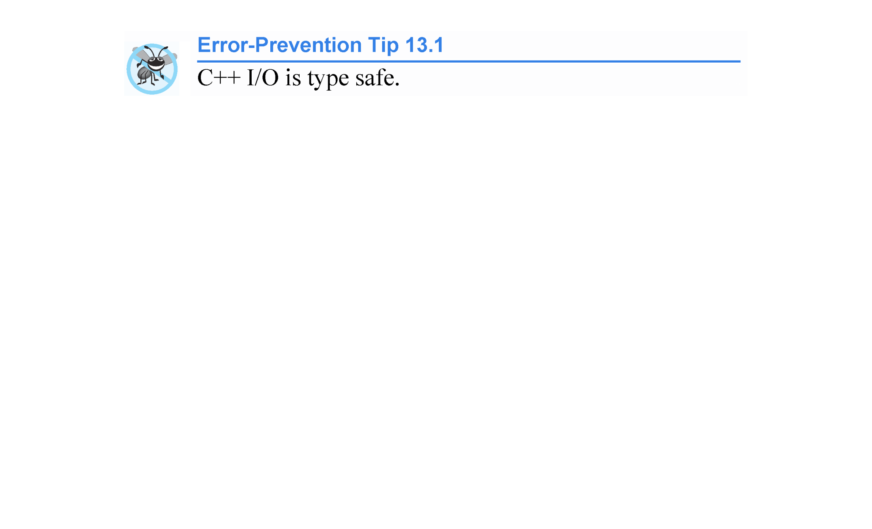

Slide 8
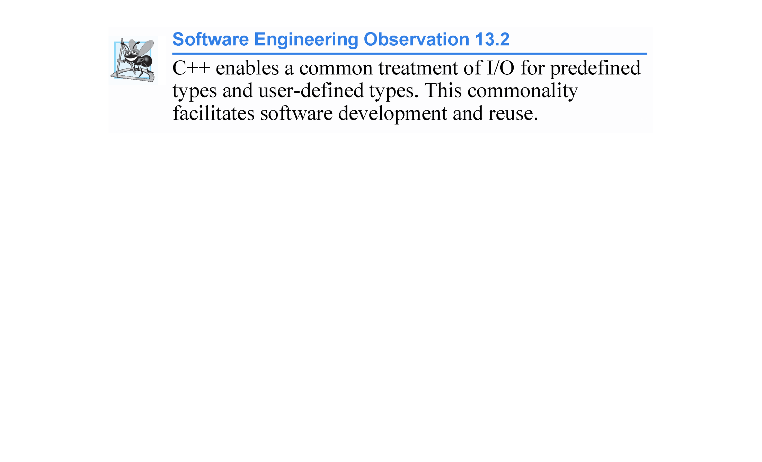

Slide 9
13.2 Streams
C++ I/O occurs in streams, which are sequences of bytes.
In input operations, the bytes flow from a device (e.g., a keyboard, a disk drive, a network connection, etc.) to main memory.
In output operations, bytes flow from main memory to a device (e.g., a display screen, a printer, a disk drive, a network connection, etc.).
An application associates meaning with bytes.
The system I/O mechanisms should transfer bytes from devices to memory (and vice versa) consistently and reliably.
Such transfers often involve some mechanical motion, such as the rotation of a disk or a tape, or the typing of keystrokes at a keyboard.
The time these transfers take is typically far greater than the time the processor requires to manipulate data internally.
Thus, I/O operations require careful planning and tuning to ensure optimal performance.

Slide 10
13.2 Streams (cont.)
C++ provides both “low-level” and “high-level” I/O capabilities.
Low-level I/O capabilities (i.e., unformatted I/O) specify that some number of bytes should be transferred device-to-memory or memory-to-device.
In such transfers, the individual byte is the item of interest.
Such low-level capabilities provide high-speed, high-volume transfers but are not particularly convenient.
Programmers generally prefer a higher-level view of I/O (i.e., formatted I/O), in which bytes are grouped into meaningful units, such as integers, floating-point numbers, characters, strings and user-defined types.
These type-oriented capabilities are satisfactory for most I/O other than high-volume file processing.

Slide 11
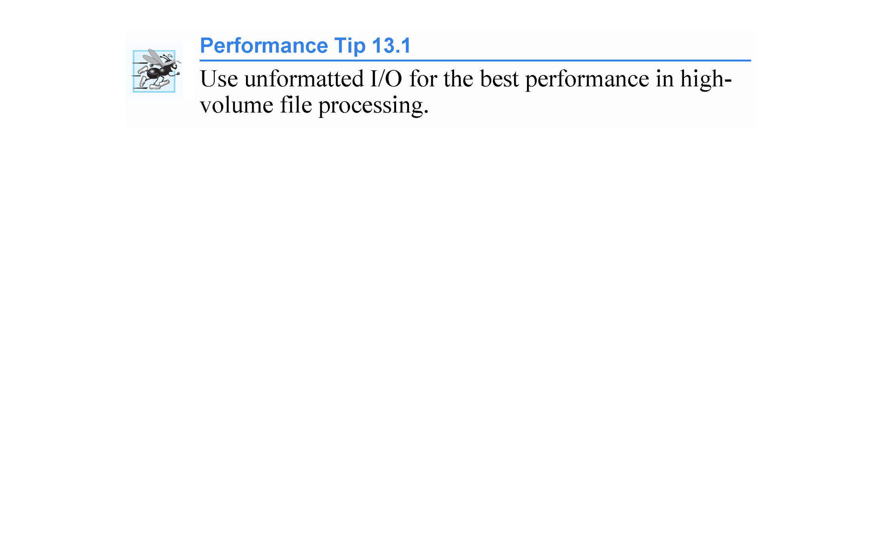

Slide 12
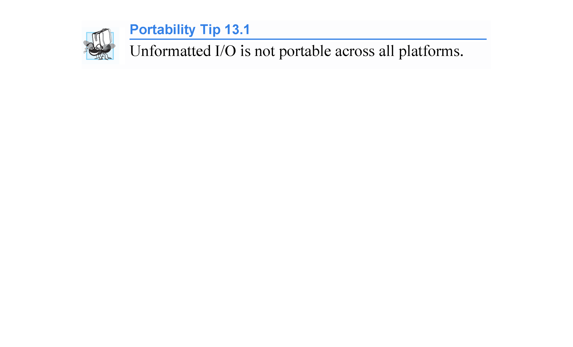
The size in bytes of fundamental data types depends on the underlying platform.
long long int >= long int >= int >= short int
long long double >= long double >= double >= float
Size in bytes is relative, not absolute!
Remember integer and char data types may be signed or unsigned.

Slide 13
13.2.1 Classic Streams vs. Standard Streams one-byte char vs. 2-byte char
In the past, the C++ classic stream libraries enabled input and output of chars.
Because a char normally occupies one byte, it can represent only a limited set of characters (such as those in the ASCII character set).
However, many languages use alphabets that contain more characters than a single-byte char can represent.
The ASCII character set does not provide these characters; the Unicode® character set does.
Unicode is an extensive international character set that represents the majority of the world’s “commercially viable” languages, mathematical symbols and much more.
wchar_t data type for 2-byte (Unicode) integers

Slide 14
13.2.1 Classic Streams vs. Standard Streams (cont.)
C++ includes the standard stream libraries, which enable developers to build systems capable of performing I/O operations with Unicode characters.
For this purpose, C++ includes the type wchar_t, which can store 2-byte Unicode characters.
The C++ standard also redesigned the classic C++ stream classes, which processed only chars, as class templates with separate specializations for processing characters of types char and wchar_t, respectively.
We use the char specializations.
The size of type wchar_t is not specified by the standard. C++11’s new char16_t and char32_t types for representing Unicode characters were added to provide character types with explicitly specified sizes.

Slide 15
13.2.2 iostream Library Headers
The C++ iostream library provides hundreds of I/O capabilities.
Several header files contain portions of the library interface.
Most C++ programs include the <iostream> header, which declares basic services required for all stream-I/O operations.
The <iostream> header defines the cin, cout, cerr and clog objects, which correspond to the standard input stream, the standard output stream, the unbuffered standard error stream and the buffered standard error stream, respectively.
cin standard input
cout standard output
cerr standard error (unbuffered)
clog standard error (buffered)
Both unformatted- and formatted-I/O services are provided.

Slide 16
13.2.2 iostream Library Header s (cont.)
The <iomanip> header declares services useful for performing formatted I/O with so-called parameterized stream manipulators, such as setw and setprecision.
The <fstream> header declares services for file processing.

Slide 17
13.2.3 Stream Input/Output Classes and Objects
The iostream library provides many templates for handling common I/O operations.
Class template basic_istream supports stream-input operations
class template basic_ostream supports stream-output operations
class template basic_iostream supports both stream-input and stream-output operations.
Each template has a predefined template specialization that enables char I/O.
In addition, the iostream library provides a set of typedefs that provide aliases for these template specializations.
The typedef specifier declares synonyms (aliases) for data types.
Creating a name using typedef does not create a data type; typedef creates only a type name that may be used in the program.

Slide 18
13.2.3 Stream Input/Output Classes and Objects (cont.)
The typedef istream represents a basic_istream<char> that enables char input.
The typedef ostream represents a basic_ostream<char> that enables char output.
The typedef iostream represents a basic_iostream<char> that enables both char input and output.
We use these typedefs throughout this chapter.

Slide 19
1 //Demonstration of C++'s typedef keyword to define new type aliases 2 //Programming is such fun... 3 4 #include <iostream> 5 #include <fstream> 6 #include <string> 7 using namespace std; 8 9 int main() 10 { 11 // typedef existing type new type name (alias) 12 // ------------- --------------------- 13 typedef int Integer; 14 typedef double Real; 15 typedef char Character; 16 typedef string String; 17 typedef int * Pointer_to_Integer; 18 19 typedef int Array_10[10]; //alias is Array_10 20 //Array_10 identifier; --> int identifier[10];
21 22 typedef basic_ifstream<char> Input_File; 23 typedef basic_ofstream<char> Output_File; 24 25 Integer x; 26 Real z; 27 Character letter; 28 String name = "Jack Wilson";
29 Pointer_to_Integer intPtr = &x; 30 31 Array_10 scores = {1,2,3,4,5,6,7,8,9,10}; 32 33 Input_File inFile; inFile.open("My Input File.txt"); 34 Output_File outFile; outFile.open("My Output File.txt"); 35 }

Slide 20
13.2.3 Stream Input/Output Classes and Objects (cont.)
Templates basic_istream and basic_ostream both derive through single inheritance from base template basic_ios.
Template basic_iostream derives through multiple inheritance from templates basic_istream and basic_ostream.
The UML class diagram of Fig. 13.1 summarizes these inheritance relationships.

Slide 21
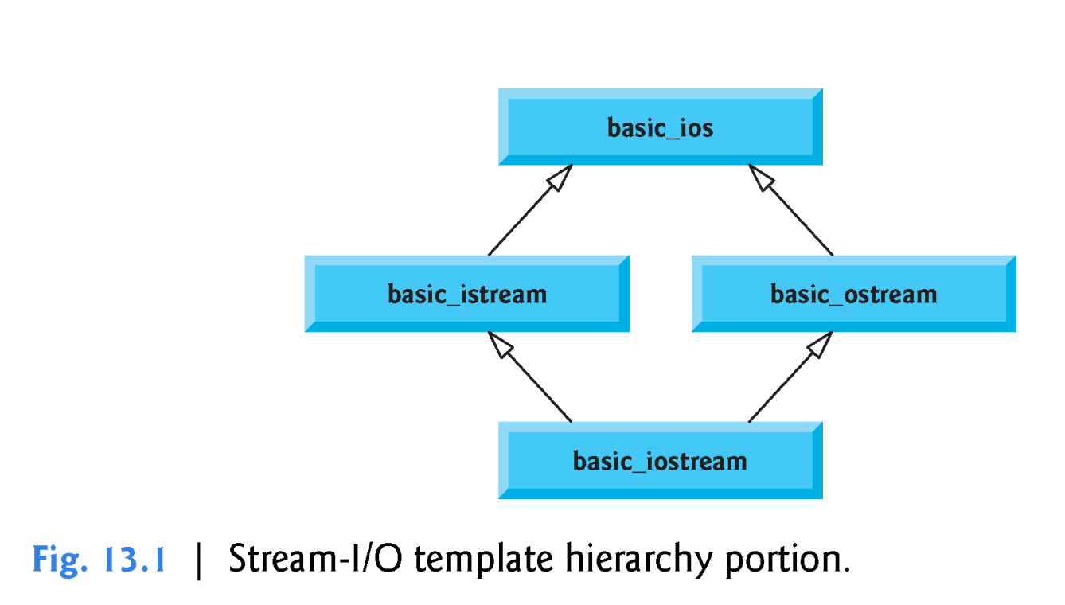

Slide 22
13.2.3 Stream Input/Output Classes and Objects (cont.)
Predefined object cin is an istream instance and is said to be “connected to” (or attached to) the standard input device, which usually is the keyboard.
The >> operator is overloaded to input data items of fundamental types, strings and pointer values.
The predefined object cout is an ostream instance and is said to be “connected to” the standard out-put device, which usually is the display screen.
The << operator is overloaded to output data items of fundamental types, strings and pointer values.

Slide 23
13.2.3 Stream Input/Output Classes and Objects (cont.)
The predefined object cerr is an ostream instance and is said to be “connected to” the standard error device, normally the screen.
Outputs to object cerr are unbuffered, implying that each stream insertion to cerr causes its output to appear immediately - this is appropriate for notifying a user promptly about errors.
The predefined object clog is an instance of the ostream class and is said to be “connected to” the standard error device.
Outputs to clog are buffered.
This means that each insertion to clog could cause its output to be held in a buffer until the buffer is filled or until the buffer is flushed.
Buffering is an I/O performance-enhancement technique discussed in operating-systems courses.

Slide 24
13.2.3 Stream Input/Output Classes and Objects (cont.)
File-Processing Templates
C++ file processing uses class templates basic_ifstream (for file input), basic_ofstream (for file output) and basic_fstream (for file input and output).
As with standard streams, C++ provides typedefs for working with these class templates.
The typedef ifstream represents a basic_ifstream<char> that enables char input from a file.
The typedef ofstream represents a basic_ofstream<char> that enables char output to a file.
The typedef fstream represents a basic_fstream<char> that enables char input from, and output to, a file.

Slide 25
13.2.3 Stream Input/Output Classes and Objects (cont.)
Template basic_ifstream inherits from basic_istream, basic_ofstream inherits from basic_ostream and basic_fstream inherits from basic_iostream.
The UML class diagram of Fig. 13.2 summarizes the various inheritance relationships of the I/O-related classes.
The full stream-I/O class hierarchy provides most of the capabilities that you need.
Consult the class-library reference for your C++ system for additional file-processing information.

Slide 26
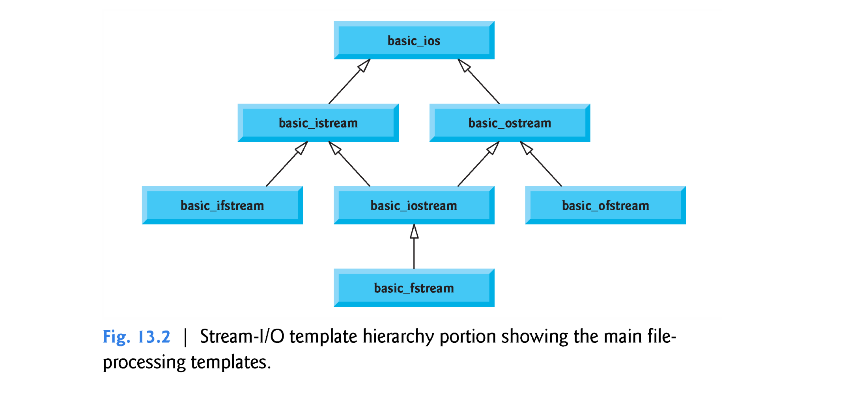
Template Hierarchy

Slide 27
13.3 Stream Output
Formatted and unformatted output capabilities are provided by ostream.

Slide 28
13.3.1 Output of char * Variables
The << operator has been overloaded to output a char * as a null-terminated C-style string.
To output the address, you can cast the char * to a void * (this can be done to any pointer variable).
Figure 13.3 demonstrates printing a char * variable in both string and address formats.
The address prints as a hexadecimal (base-16) number—in general, the way addresses print is implementation dependent.
To learn more about hexadecimal numbers, see Appendix D.

Slide 29
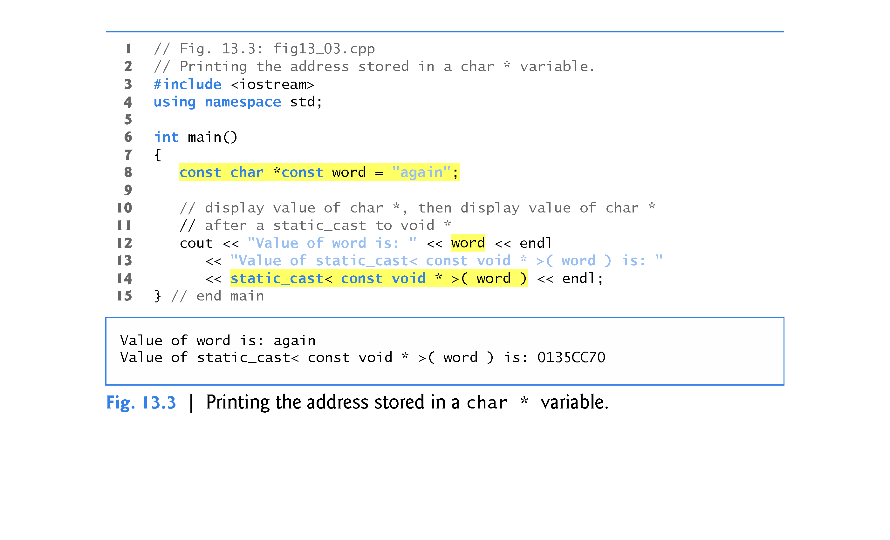

Slide 30
13.3.2 Character Output Using Member Function put
We can use the put member function to output characters.
For example, the statement
cout.put( 'A' );
displays a single character A.
Calls to put may be cascaded, as in the statement
cout.put( 'A' ).put( '\n' );
which outputs the letter A followed by a newline character.
As with <<, the preceding statement executes in this manner, because the dot operator (.) associates from left to right, and the put member function returns a reference to the ostream object (cout) that received the put call.
The put function also may be called with a numeric expression that represents an ASCII value, as in the following statement
cout.put( 65 );
which also outputs A.

Slide 31
13.4 Stream Input
Formatted and unformatted input capabilities are provided by istream.
The stream extraction operator (>>) normally skips white-space characters (such as blanks, tabs and newlines) in the input stream; later we’ll see how to change this behavior.
After each input, the stream extraction operator returns a reference to the stream object that received the extraction message (e.g., cin in the expression cin >> grade).
If that reference is used as a condition, the stream’s overloaded void * cast operator function is implicitly invoked to convert the reference into a non-null pointer value or the null pointer based on the success or failure, respectively of the last input operation.
A non-null pointer converts to the bool value true to indicate success and the null pointer converts to the bool value false to indicate failure.
When an attempt is made to read past the end of a stream, the stream’s overloaded void * cast operator returns the null pointer to indicate end-of-file.

Slide 32
13.4 Stream Input (cont.)
Each stream object contains a set of state bits used to control the stream’s state (i.e., formatting, setting error states, etc.).
These bits are used by the stream’s overloaded void * cast operator to determine whether to return a non-null pointer or the null pointer.
Stream extraction causes the stream’s failbit to be set if data of the wrong type is input and causes the stream’s badbit to be set if the operation fails.

Slide 33
13.4.1 get and getline Member Functions
The get member function with no arguments inputs one character from the designated stream (including white-space characters and other nongraphic characters, such as the key sequence that represents end-of-file) and returns it as the value of the function call.
char letter = cin.get();
This version of get returns EOF when end-of-file is encountered on the stream.

Slide 34
13.4.1 get and getline Member Functions
Using Member Functions eof, get and put
Figure 13.4 demonstrates the use of member functions eof and get on input stream cin and member function put on output stream cout.
This program reads characters into the int variable character, so that we can test each character entered to see if it’s EOF.
The user enters a line of text and presses Enter followed by end-of-file (<Ctrl> z on Microsoft Windows systems, <Ctrl> d on Linux and Mac systems).
This program uses the version of istream member function get that takes no arguments and returns the character being input (line 15).
Function eof returns true only after the program attempts to read past the last character in the stream.

Slide 35
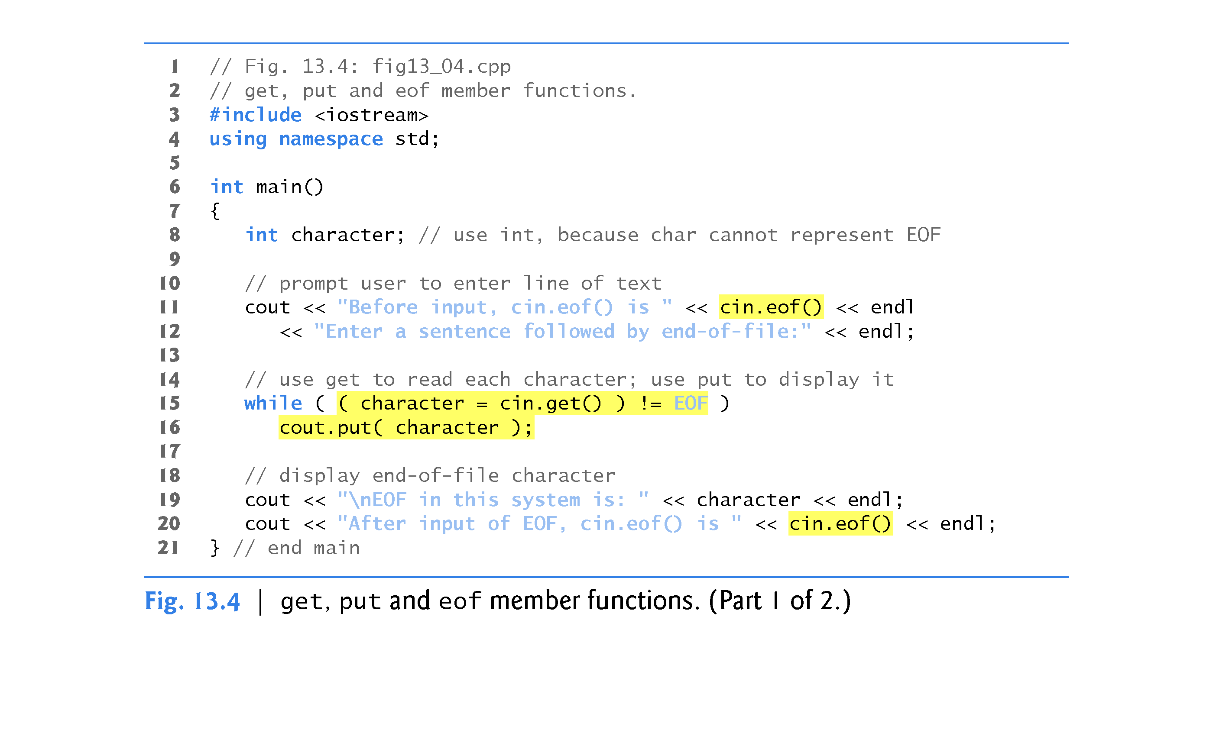

Slide 36
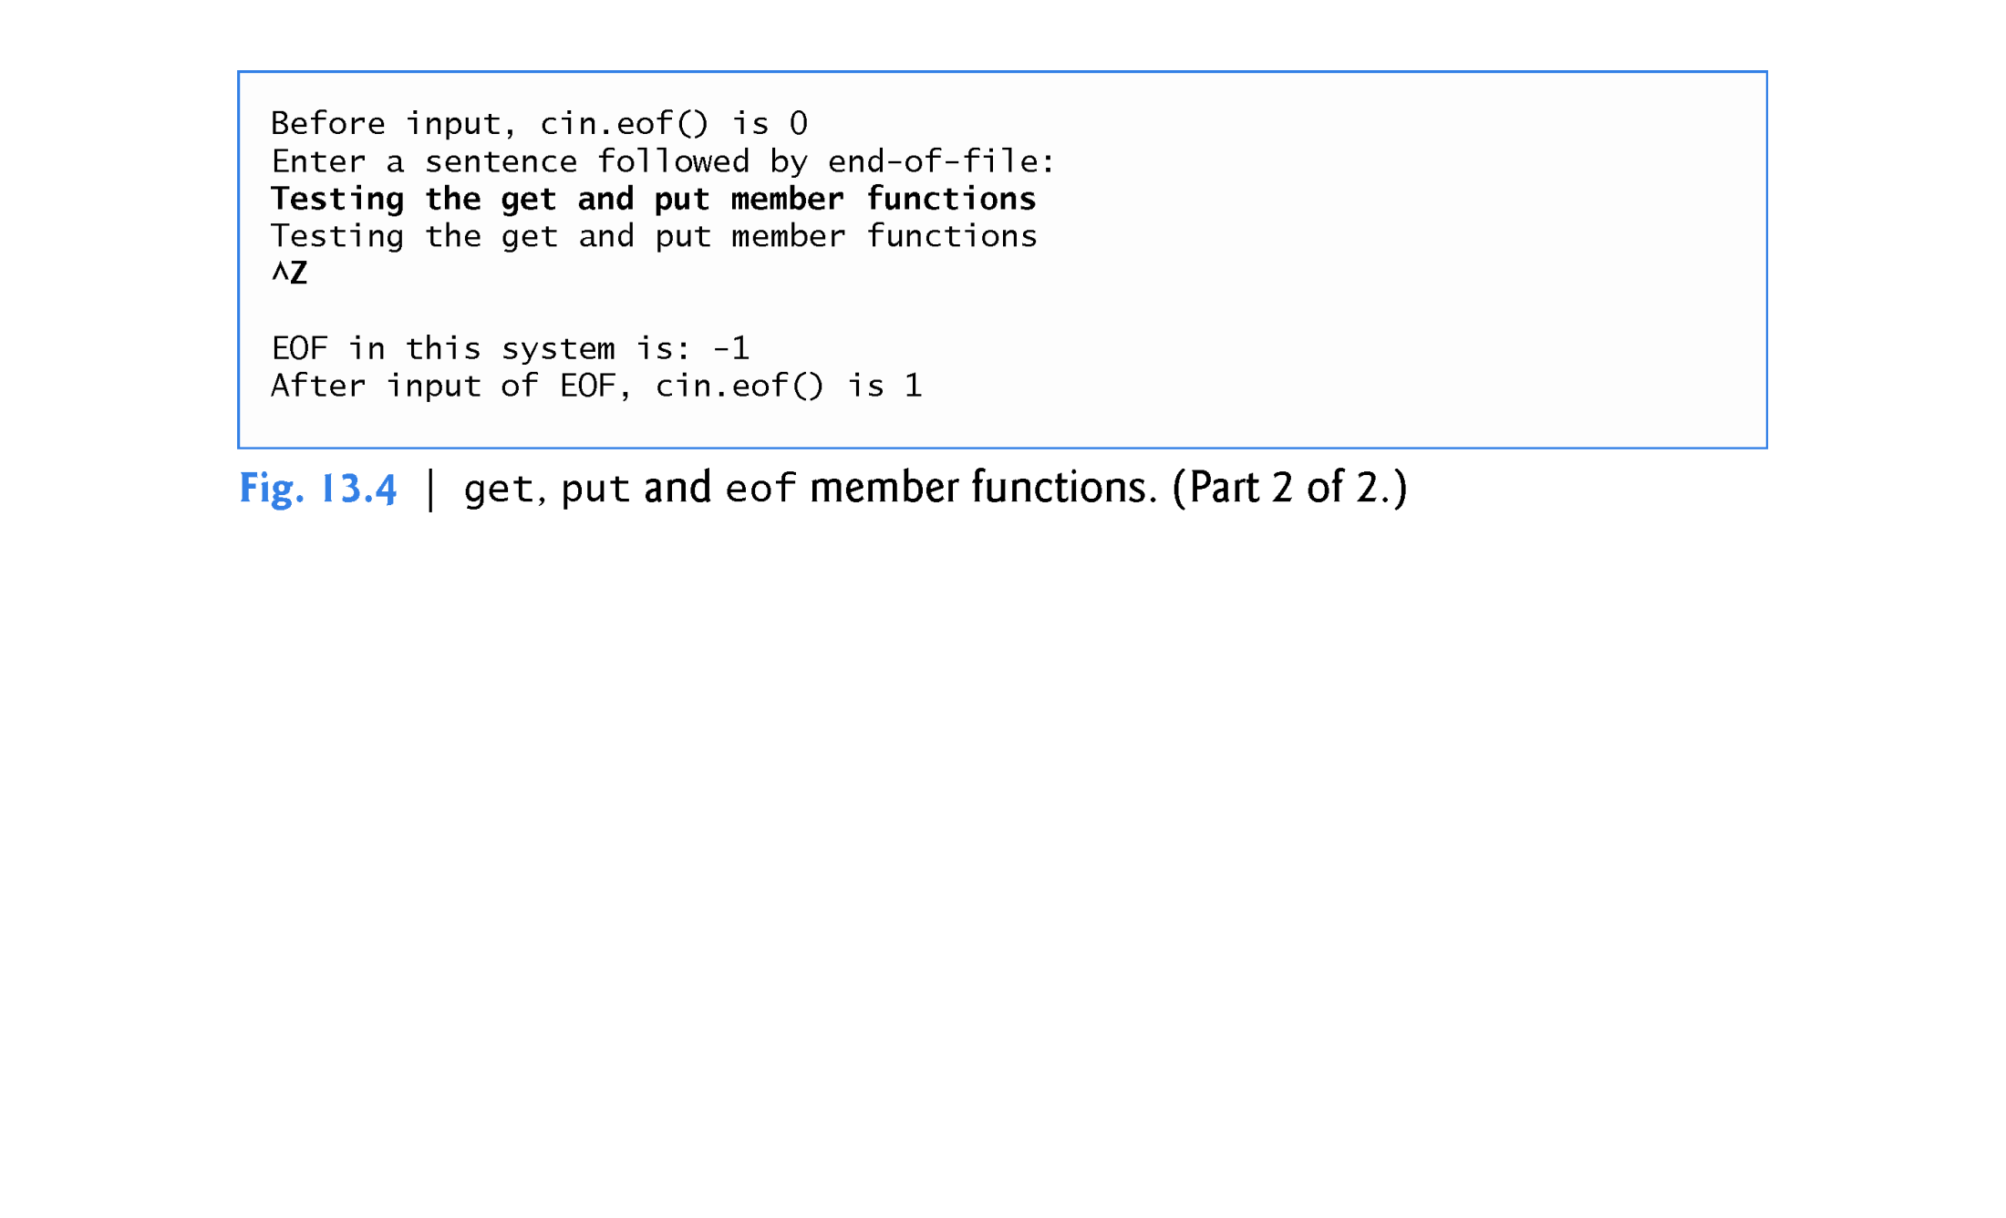

Slide 37
13.4.1 get and getline Member Functions (cont.)
The get member function with a character-reference argument inputs the next character from the input stream (even if this is a white-space character) and stores it in the character argument.
int x; cin.get(x); //x is passed by reference
This version of get returns a reference to the istream object for which the get member function is being invoked.
A third version of get takes three arguments—a built-in array of chars, a size limit and a delimiter (with default value '\n').
char sentence[61]; cin.get(sentence, 61, ‘\n’) or cin.get(sentence, 61);
This version reads characters from the input stream.
It either reads one fewer than the specified maximum number of characters and terminates or terminates as soon as the delimiter is read.
A null character is inserted to terminate the input string in the character array used as a buffer by the program.
The delimiter is not placed in the character array but does remain in the input stream (the delimiter will be the next character read).

Slide 38
13.4.1 get and getline Member Functions (cont.)
Figure 13.5 compares input using stream extraction with cin (which reads characters until a white-space character is encountered) and input using cin.get.
The call to cin.get (line 22) does not specify a delimiter, so the default '\n' character is used.

Slide 39
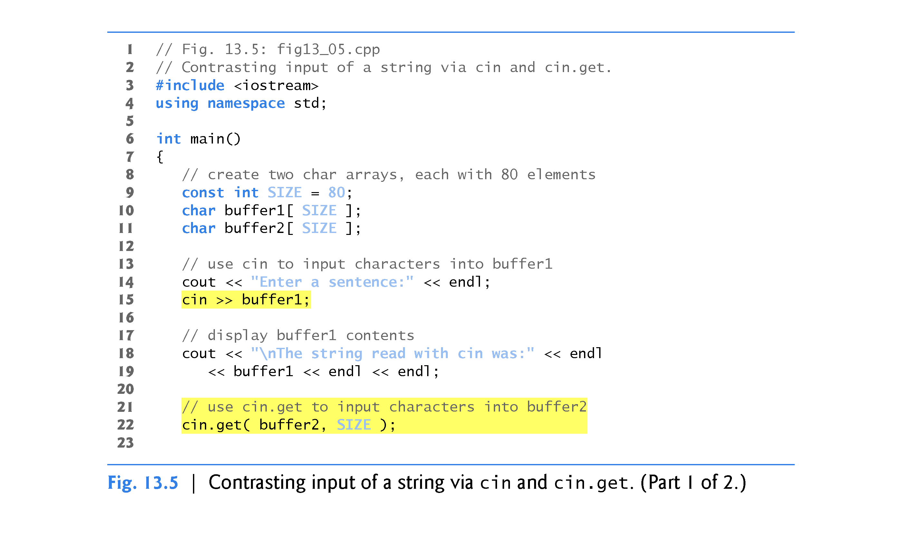

Slide 40
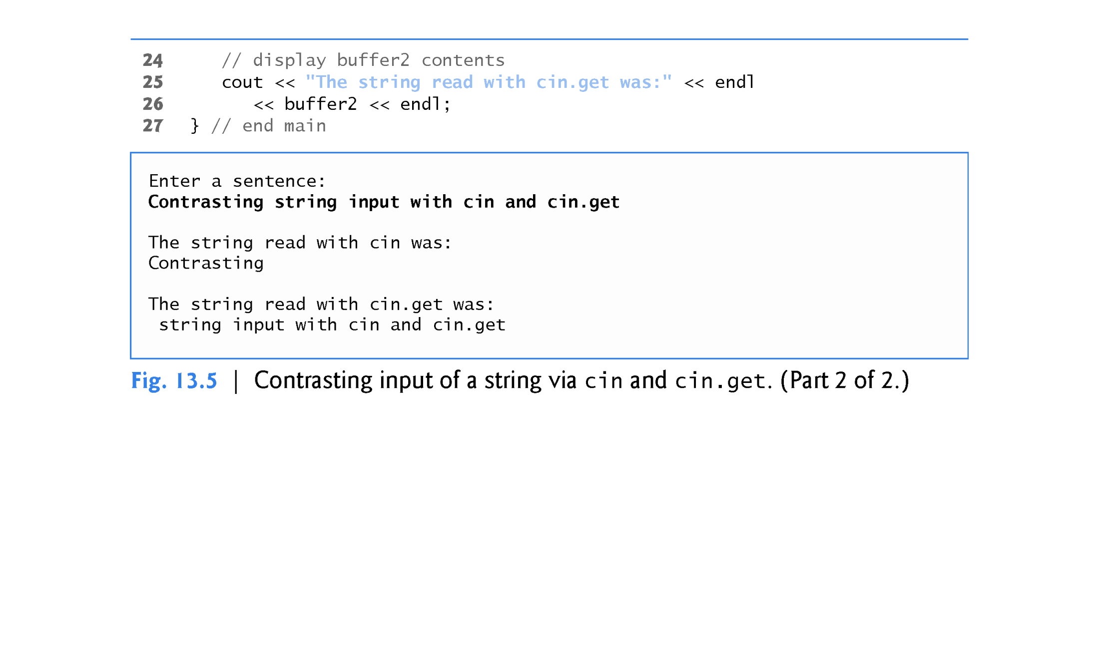

Slide 41
13.4.1 get and getline Member Functions (cont.)
Using Member Function getline
Member function getline operates similarly to the third version of the get member function and inserts a null character after the line in the character array.
The getline member function removes the delimiter from the stream (i.e., reads the character and discards it).
The program of Fig. 13.6 demonstrates the use of the getline member function to input a line of text (line 13).

Slide 42
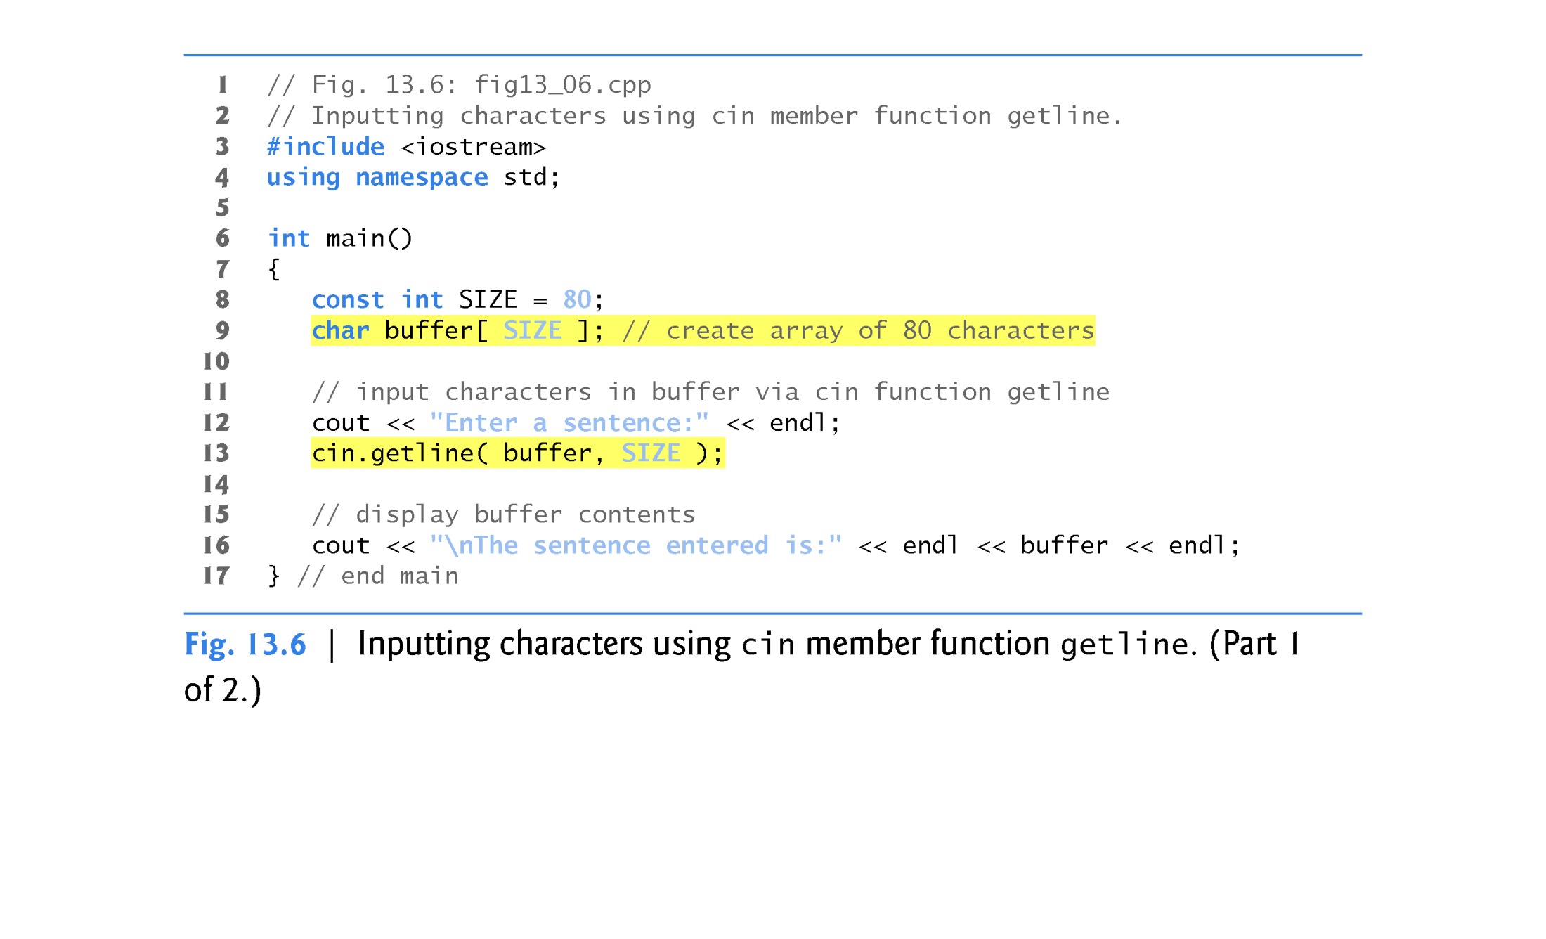

Slide 43
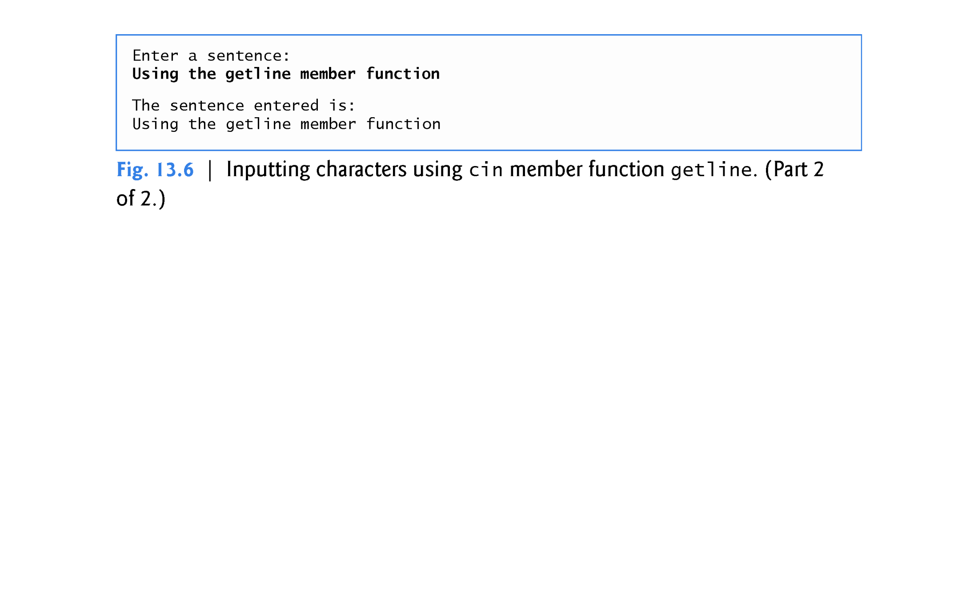

Slide 44
13.4.2 istream Member Functions peek, putback and ignore
The ignore member function of istream reads and discards a designated number of characters (the default is one) or terminates upon encountering a designated delimiter (the default is EOF, which causes ignore to skip to the end of the file when reading from a file).
The putback member function places the previous character obtained by a get from an input stream back into that stream.
This function is useful for applications that scan an input stream looking for a field beginning with a specific character.
When that character is input, the application returns the character to the stream, so the character can be included in the input data.
The peek member function returns the next character from an input stream but does not remove the character from the stream.

Slide 45
13.4.3 Type-Safe I/O
C++ offers type-safe I/O.
The << and >> operators are overloaded to accept data items of specific types.
If unexpected data is processed, various error bits are set, which the user may test to determine whether an I/O operation succeeded or failed.
If operator << or >> has not been overloaded for a user-defined type and you attempt to input into or output the contents of an object of that user-defined type, the compiler reports an error.
This enables the program to “stay in control.”

Slide 46
13.5 Unformatted I/O Using read, write and gcount (read/write some number of bytes)
Unformatted input/output is performed using the read and write member functions of istream and ostream, respectively.
Member function read inputs bytes to a built-in array of chars in memory; member function write outputs bytes from a built-in array of chars .
These bytes are not formatted in any way.
They’re input or output as raw bytes.
The read member function inputs a designated number of characters into a character array.
If fewer than the designated number of characters are read, failbit is set.
Section 13.8 shows how to determine whether failbit has been set.
Member function gcount reports the number of characters read by the last input operation.

Slide 47
13.5 Unformatted I/O Using read, write and gcount
Figure 13.7 demonstrates istream member functions read and gcount, and ostream member function write.
const int SIZE = 81;
char array[SIZE];
cout << “Enter a sentence” << endl;
cin.read( array, 20 ); //read exactly 20 characters (any characters)
//cin.gcount() //number of characters read (including whitespace)
cout.write( array, cin.gcount() ); cout << endl;

Slide 48
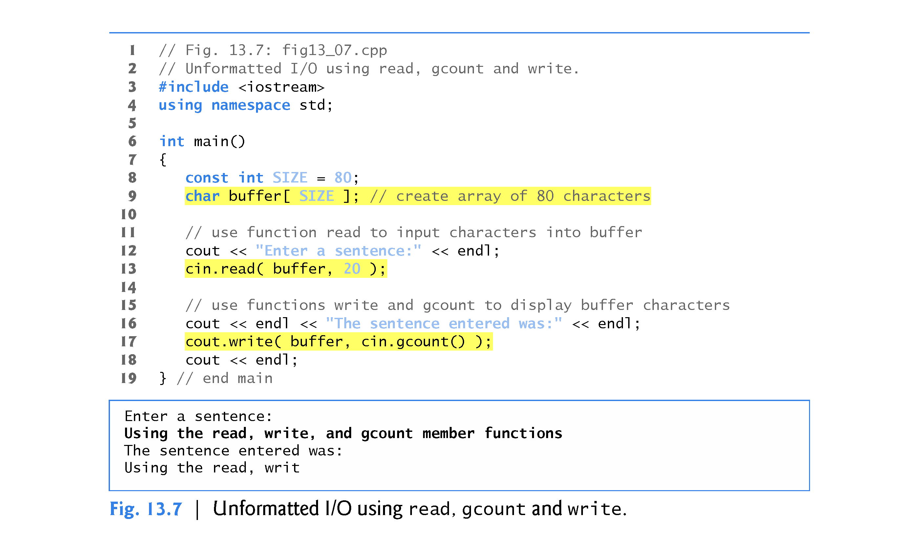

Slide 49
13.6 Introduction to Stream Manipulators
C++ provides various stream manipulators that perform formatting tasks.
The stream manipulators provide capabilities such as setting field widths, setting precision, setting and unsetting format state, setting the fill character in fields, flushing streams, inserting a newline into the output stream (and flushing the stream), inserting a null character into the output stream and skipping white space in the input stream.
These features are described in the following sections.

Slide 50
13.6.1 Integral Stream Base: dec, oct, hex and setbase
Integers are interpreted normally as decimal (base-10) values.
To change the base in which integers are interpreted on a stream, insert the hex manipulator to set the base to hexadecimal (base 16) or insert the oct manipulator to set the base to octal (base 8).
Insert the dec manipulator to reset the stream base to decimal.
These are all sticky manipulators (aka persistent).
A stream base also may be changed by the setbase stream manipulator, which takes one integer argument of 10, 8, or 16 to set the base to decimal, octal or hexadecimal, respectively.
Because setbase takes an argument, it’s called a parameterized stream manipulator.
Figure 13.8 demonstrates stream manipulators hex, oct, dec and setbase.

Slide 51
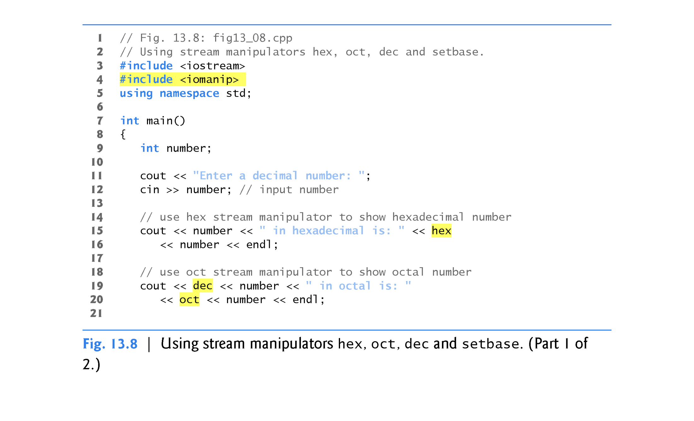

Slide 52
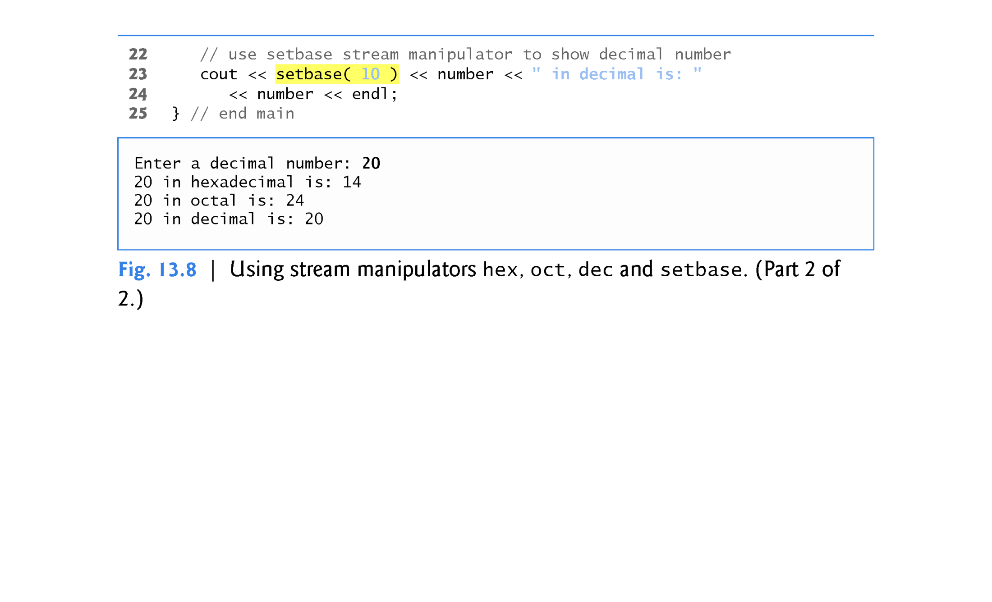

Slide 53
13.6.2 Floating-Point Precision (precision, setprecision)
We can control the precision of floating-point numbers (i.e., the number of digits to the right of the decimal point) by using either the setprecision stream manipulator or the precision member function of ios_base.
A call to either of these sets the precision for all subsequent output operations until the next precision-setting call.
A call to member function precision with no argument returns the current precision setting (this is what you need to use so that you can restore the original precision eventually after a sticky setting is no longer needed).
The program of Fig. 13.9 uses both member function precision (line 22) and the setprecision manipulator (line 31) to print a table that shows the square root of 2, with precision varying from 0 to 9.

Slide 54
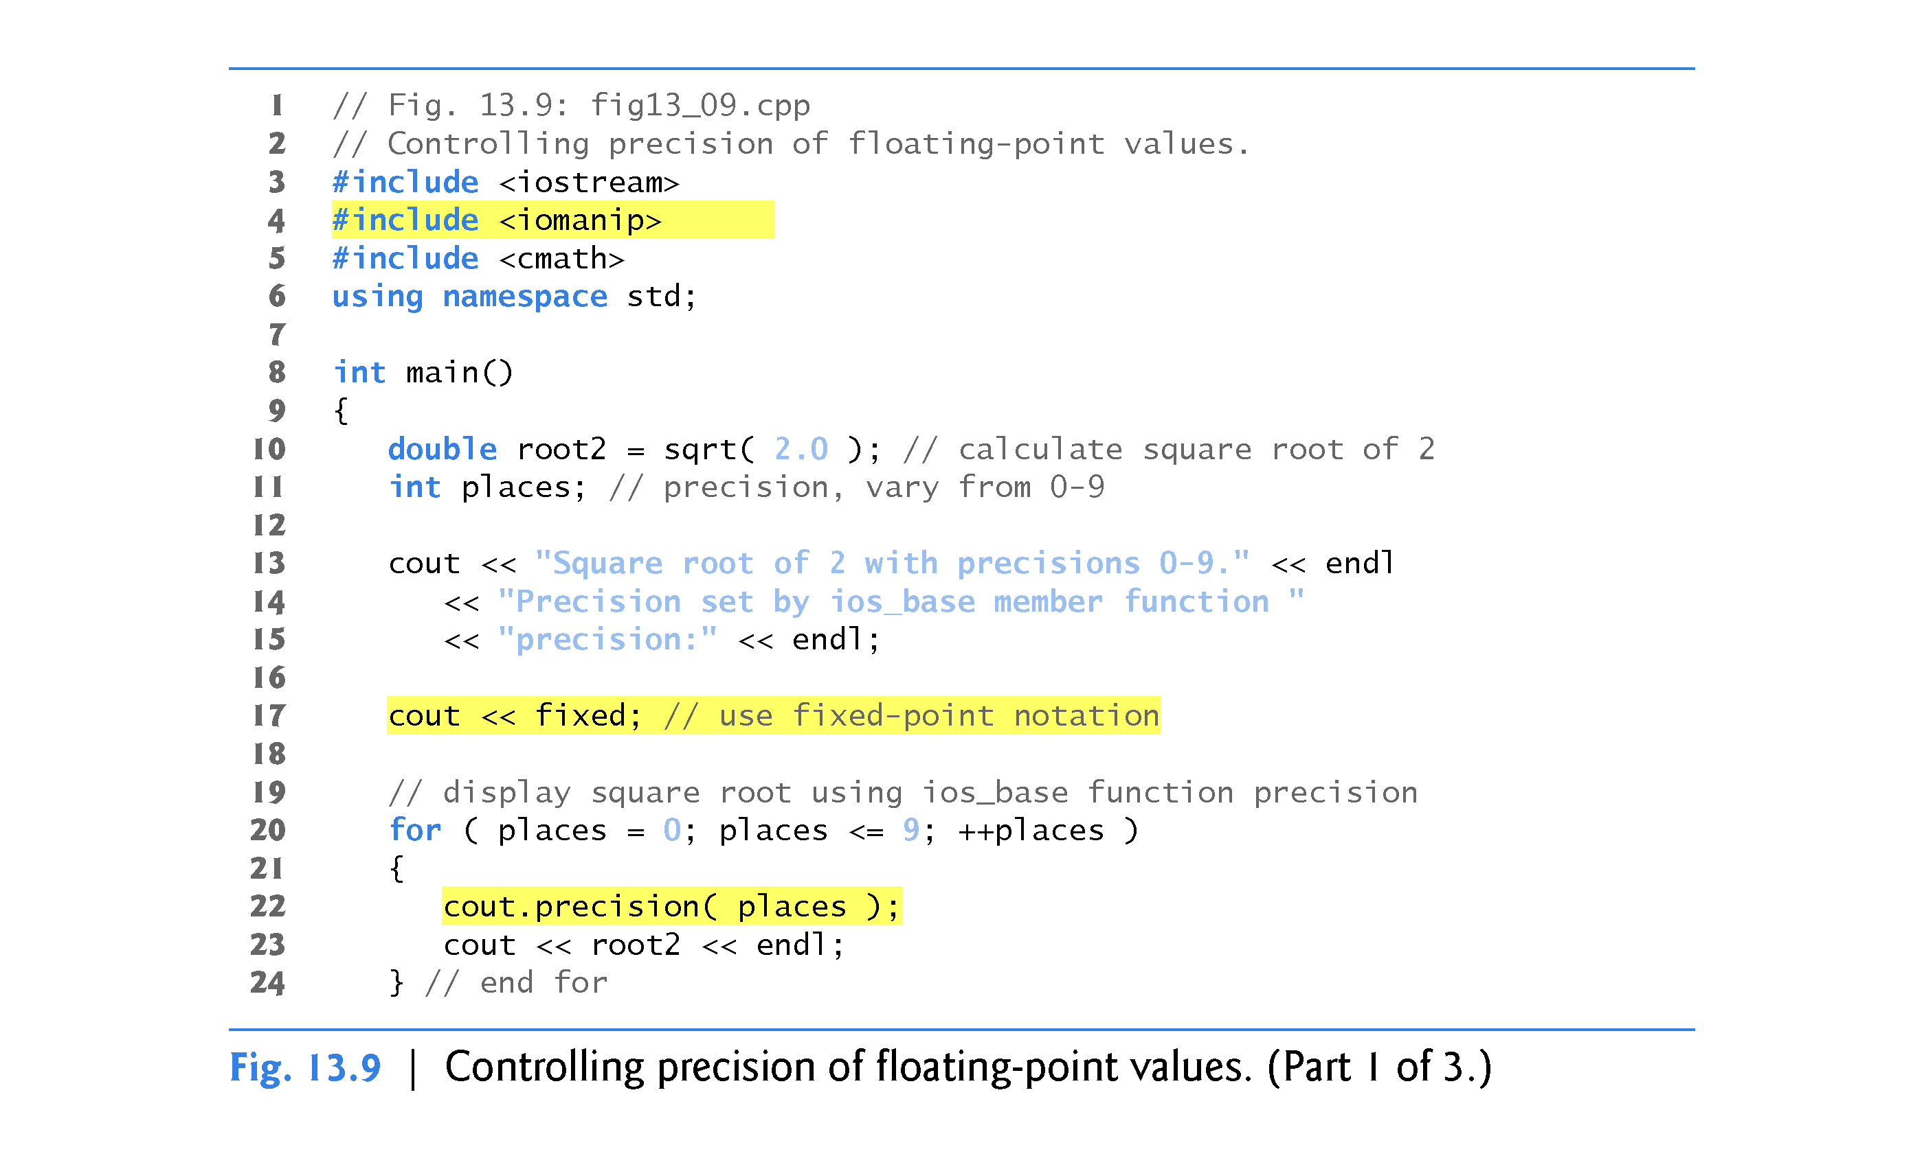

Slide 55
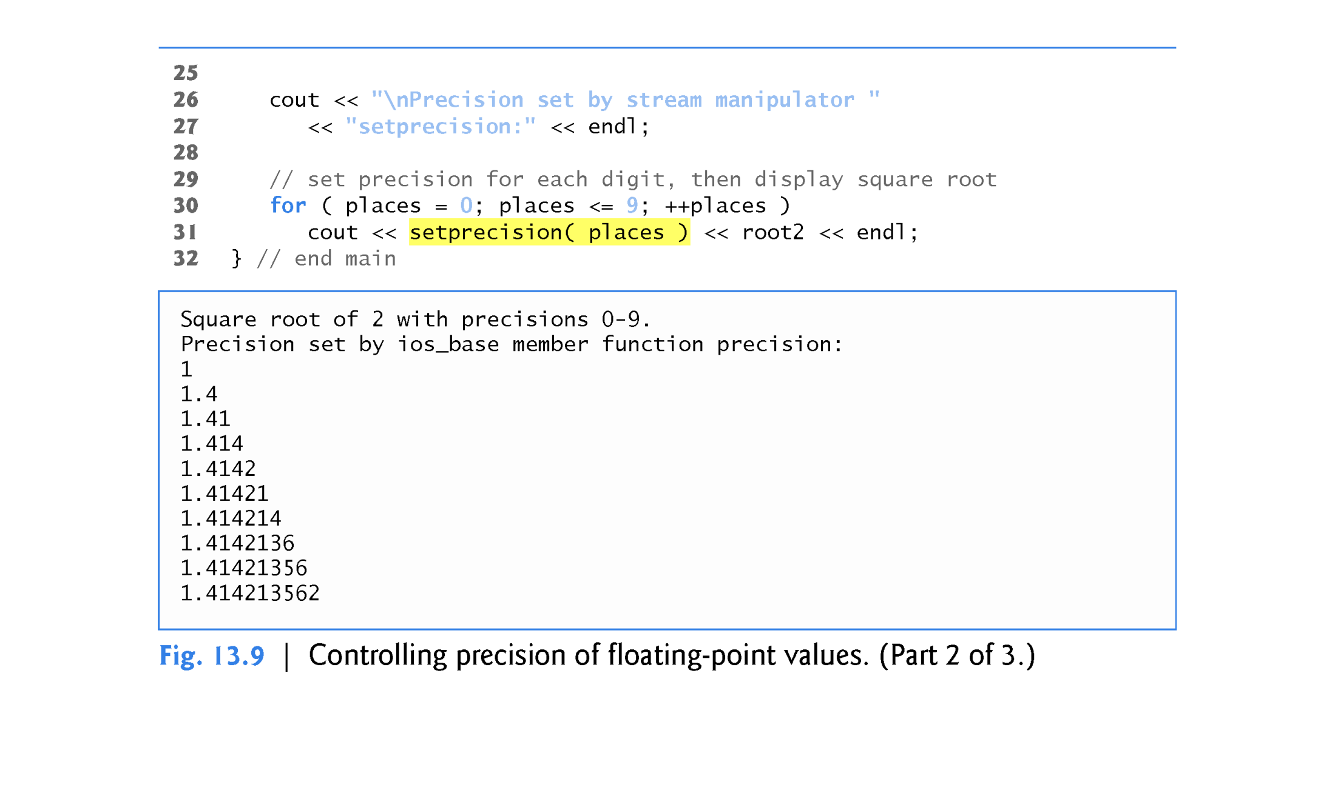

Slide 56
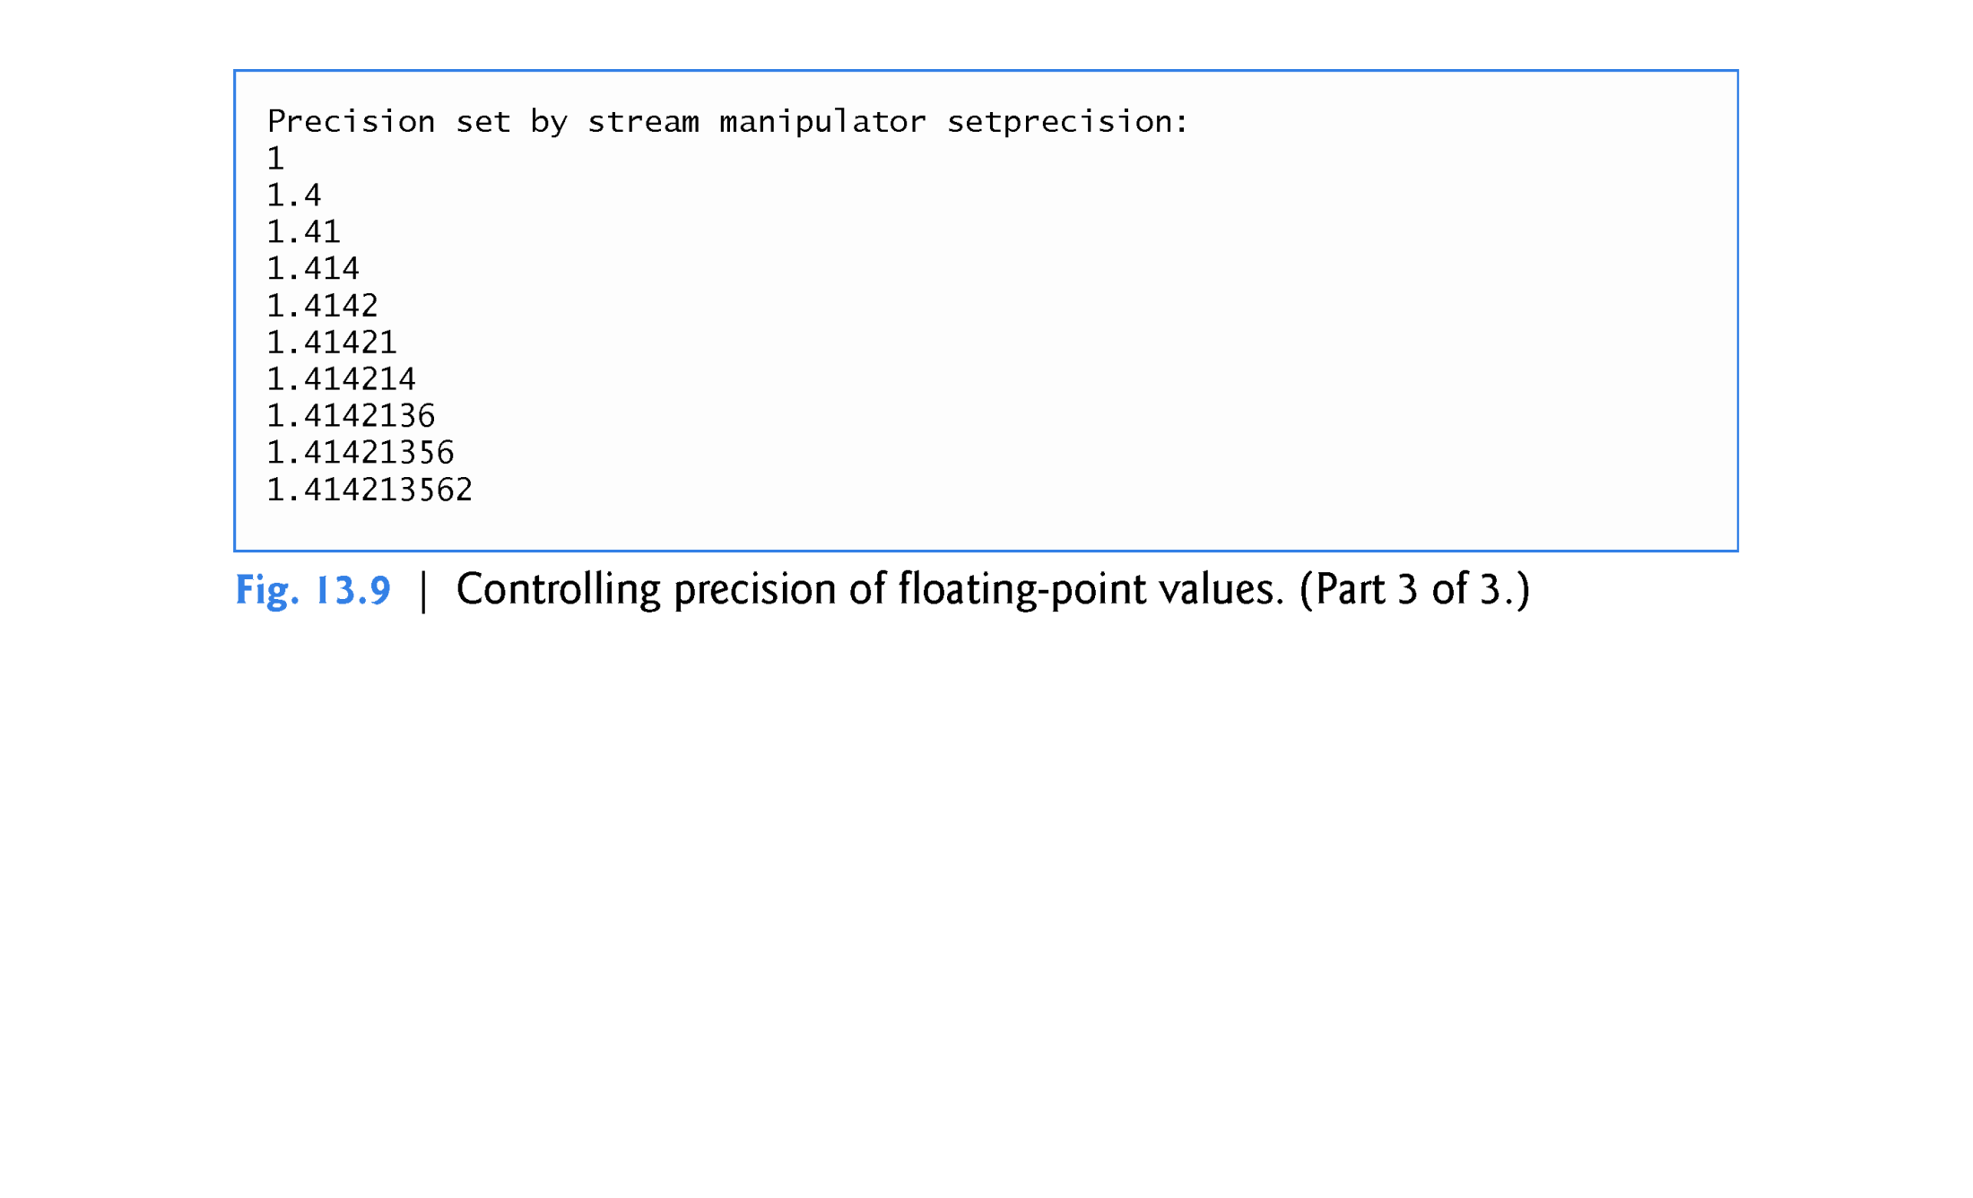

Slide 57
13.6.3 Field Width (width, setw)
The width member function (of base class ios_base) sets the field width (i.e., the number of character positions in which a value should be output or the maximum number of characters that should be input) and returns the previous width.
If values output are narrower than the field width, fill characters are inserted as padding.
A value wider than the designated width will not be truncated—the full number will be printed.
The width function with no argument returns the current setting.
Figure 13.10 demonstrates the use of the width member function on both input and output.
On input into a char array, a maximum of one fewer characters than the width will be read.
Remember that stream extraction terminates when nonleading white space is encountered.
The setw stream manipulator also may be used to set the field width.

Slide 58
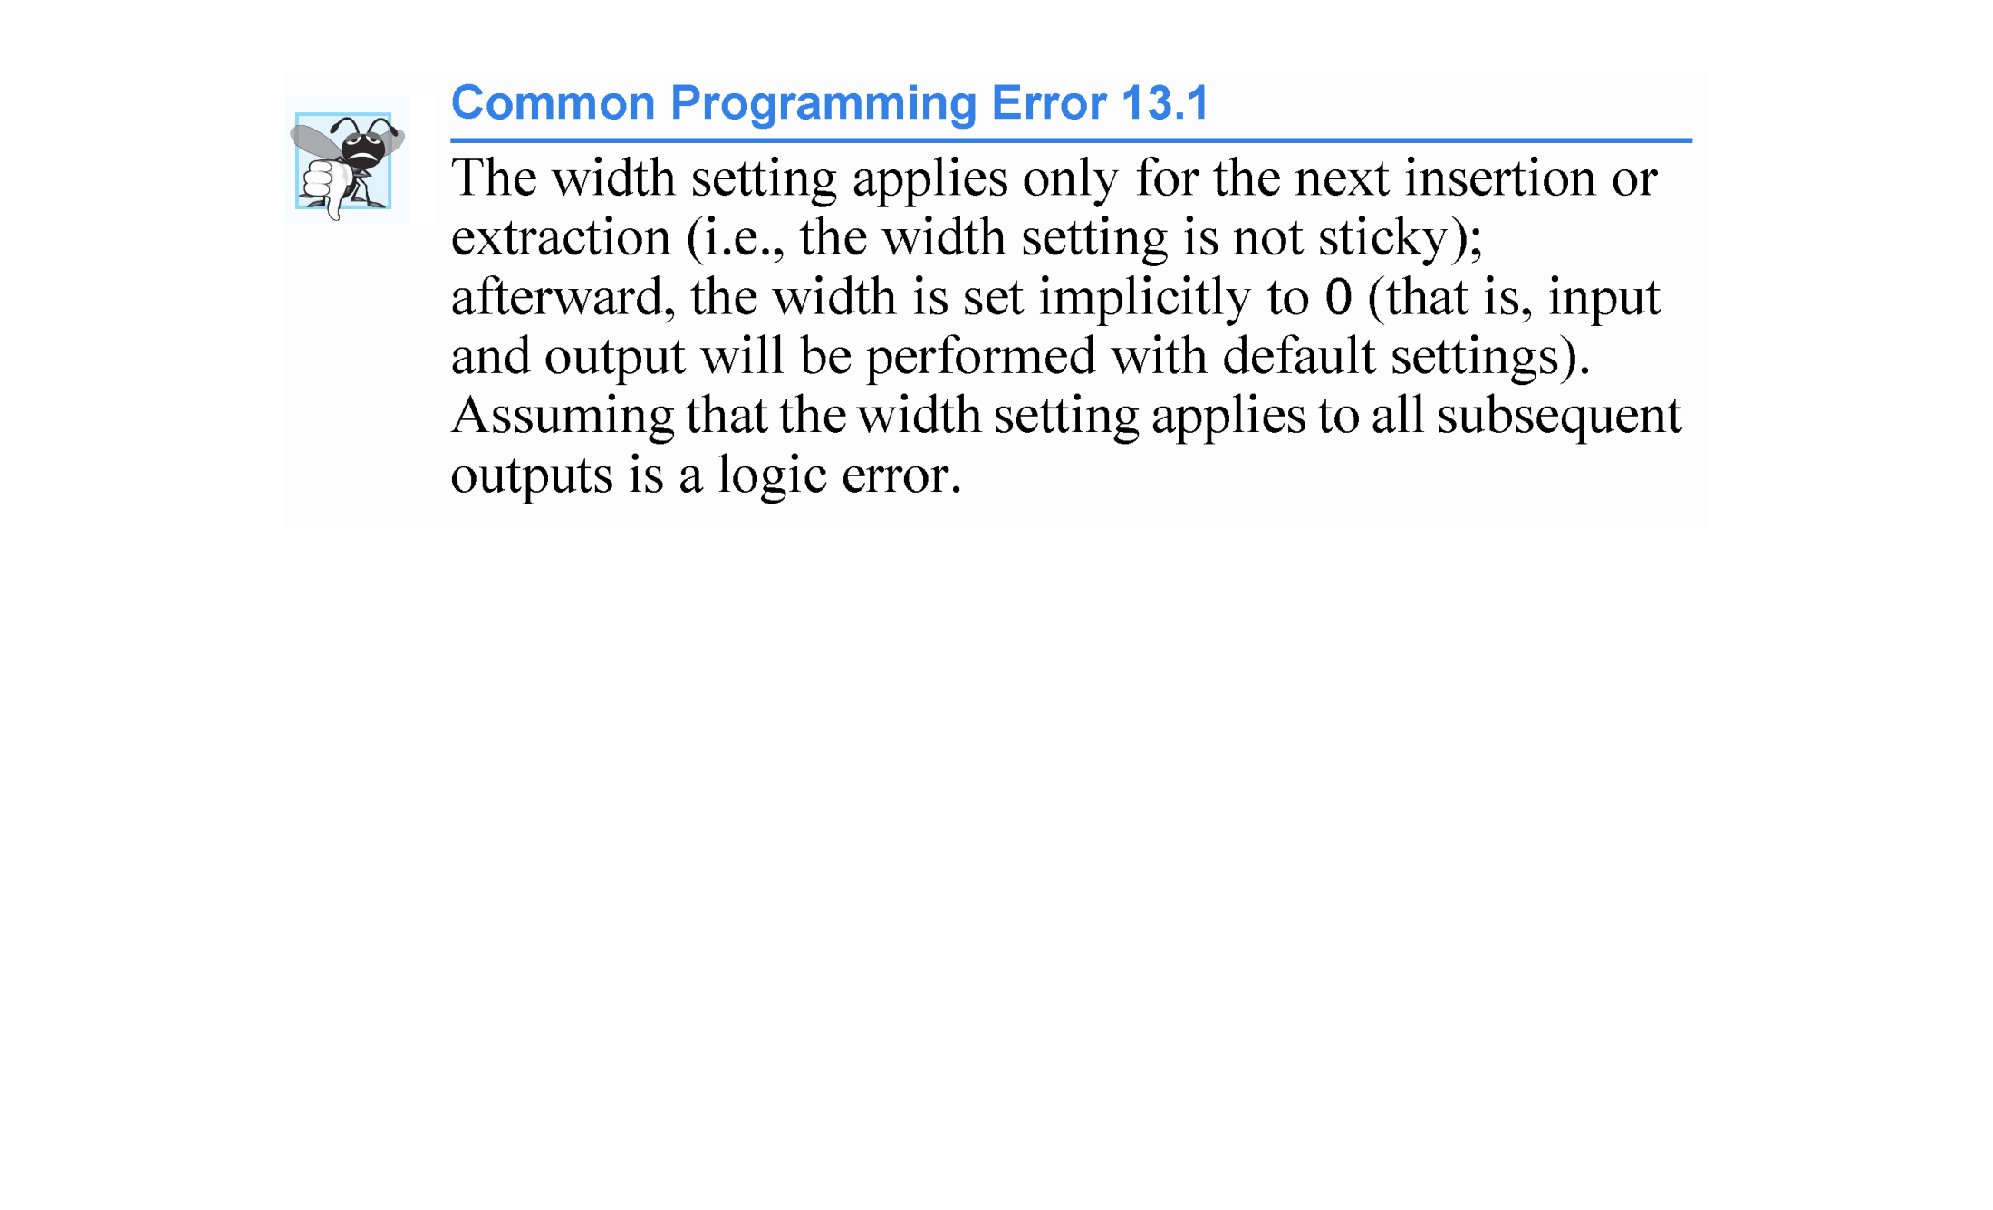

Slide 59
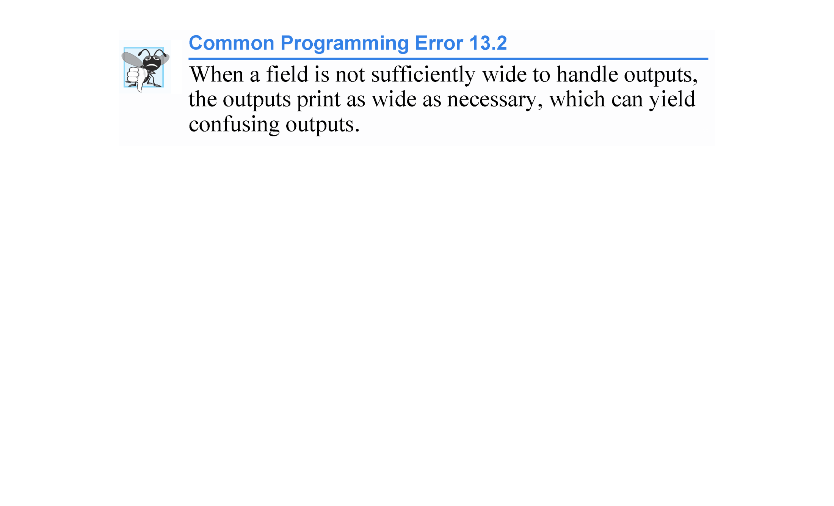

Slide 60
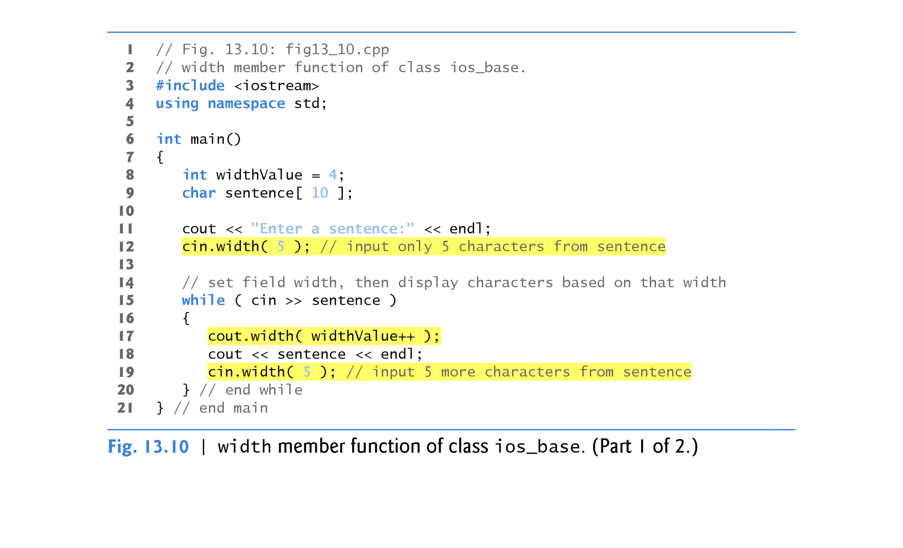

Slide 61
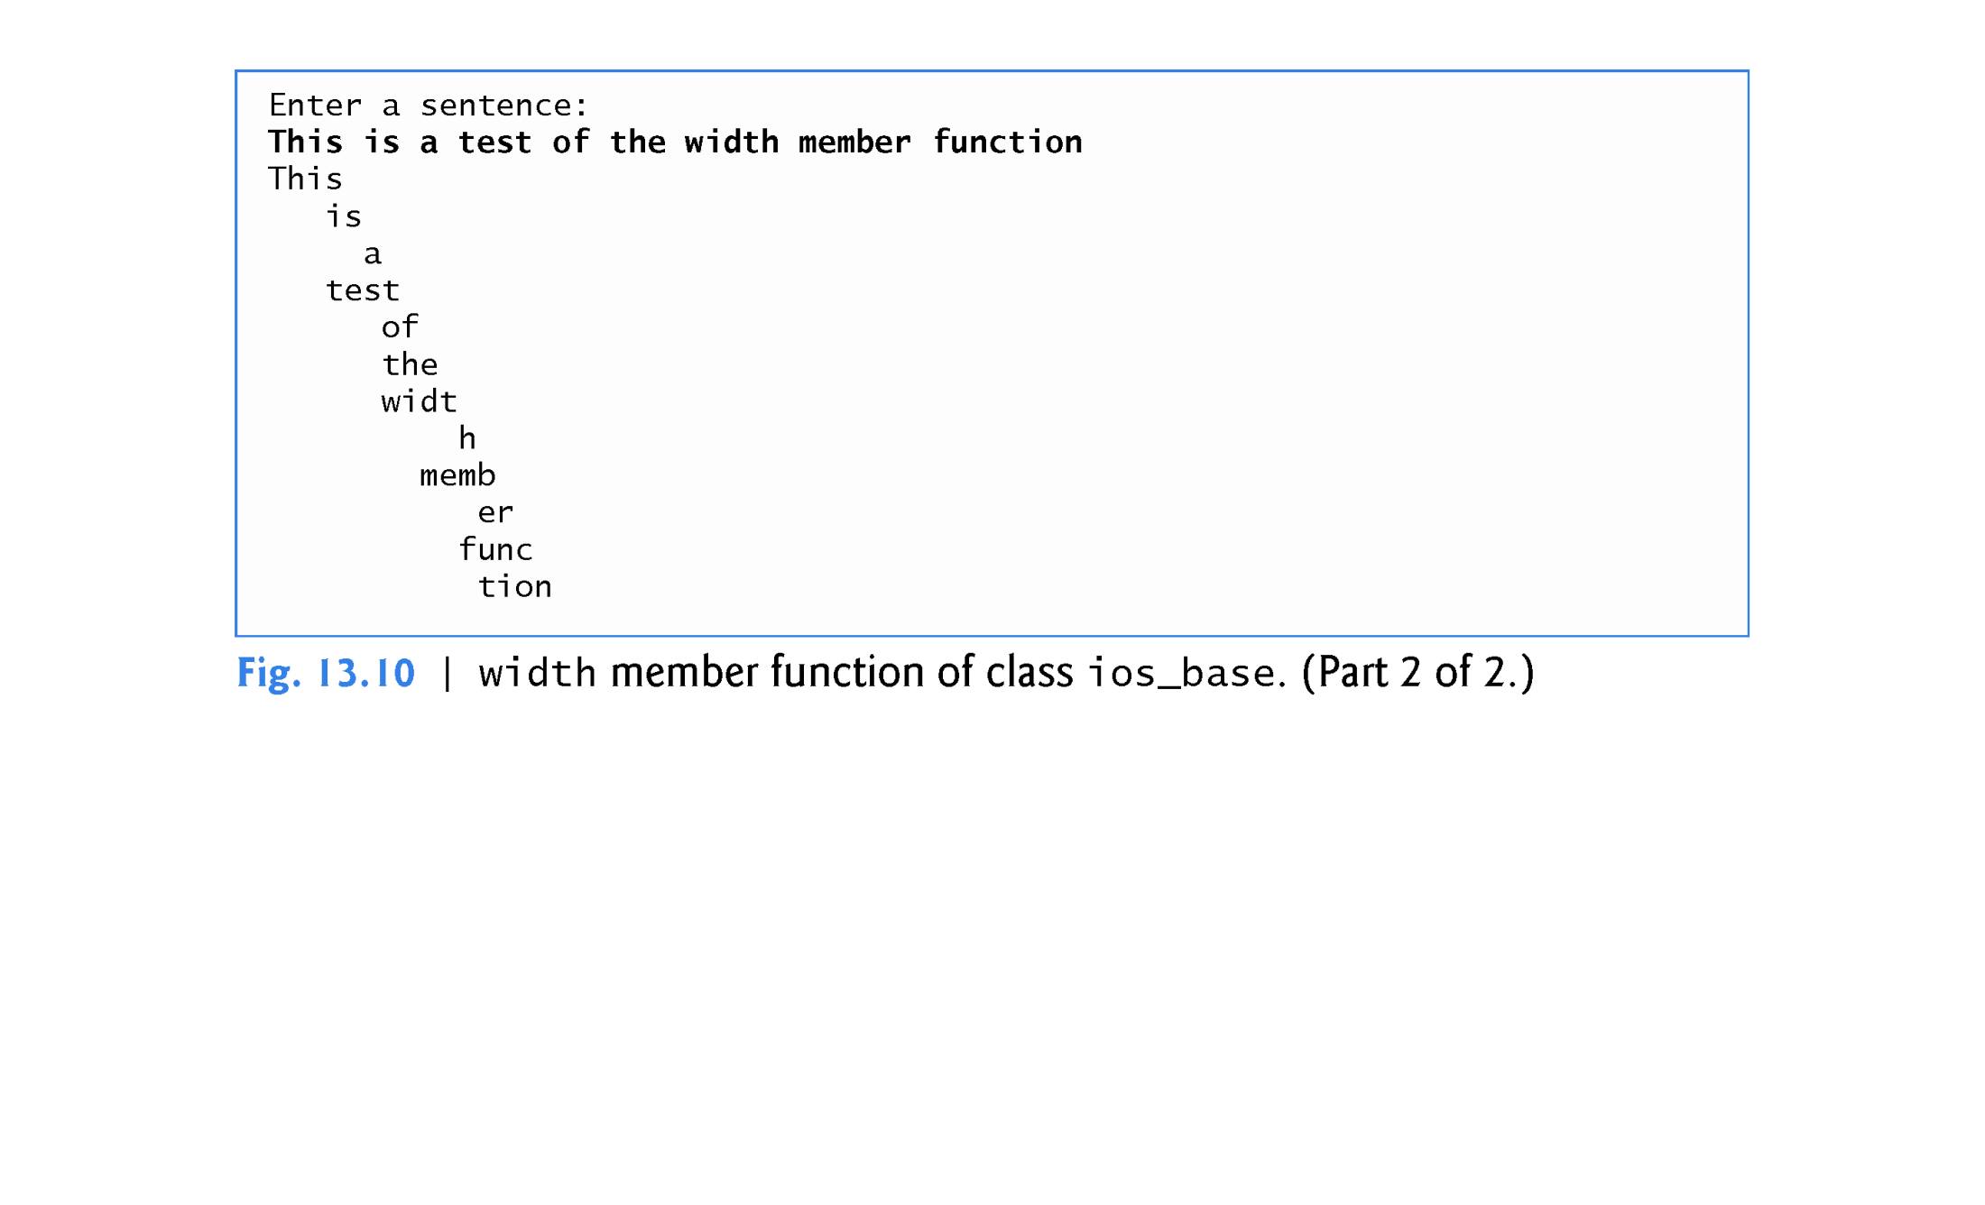

Slide 62
13.6.4 User-Defined Output Stream Manipulators
You can create your own stream manipulators.
Figure 13.11 shows how to create and use new nonparameterized stream manipulators bell (lines 8 - 11), carriageReturn (lines 14 - 17), tab (lines 20 - 23) and endLine (lines 27 - 30).
For output stream manipulators, the return type and parameter must be of type ostream &.

Slide 63
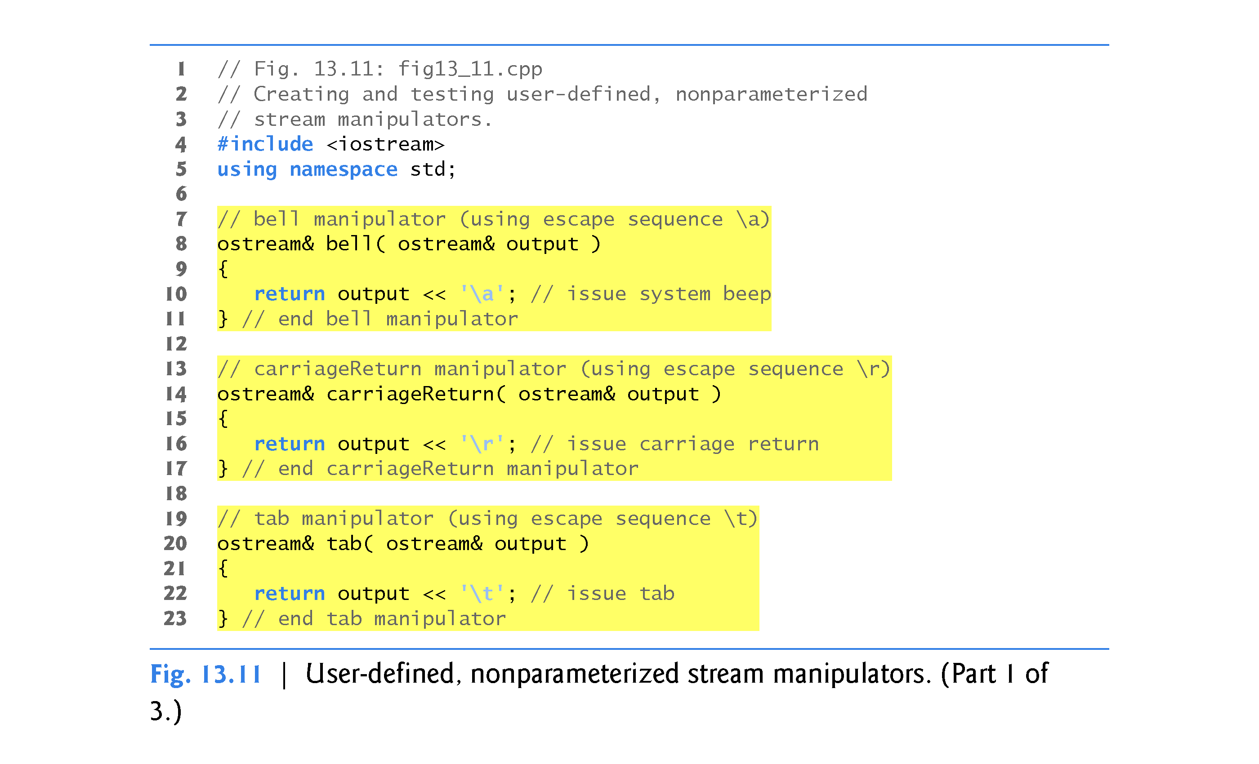

Slide 64
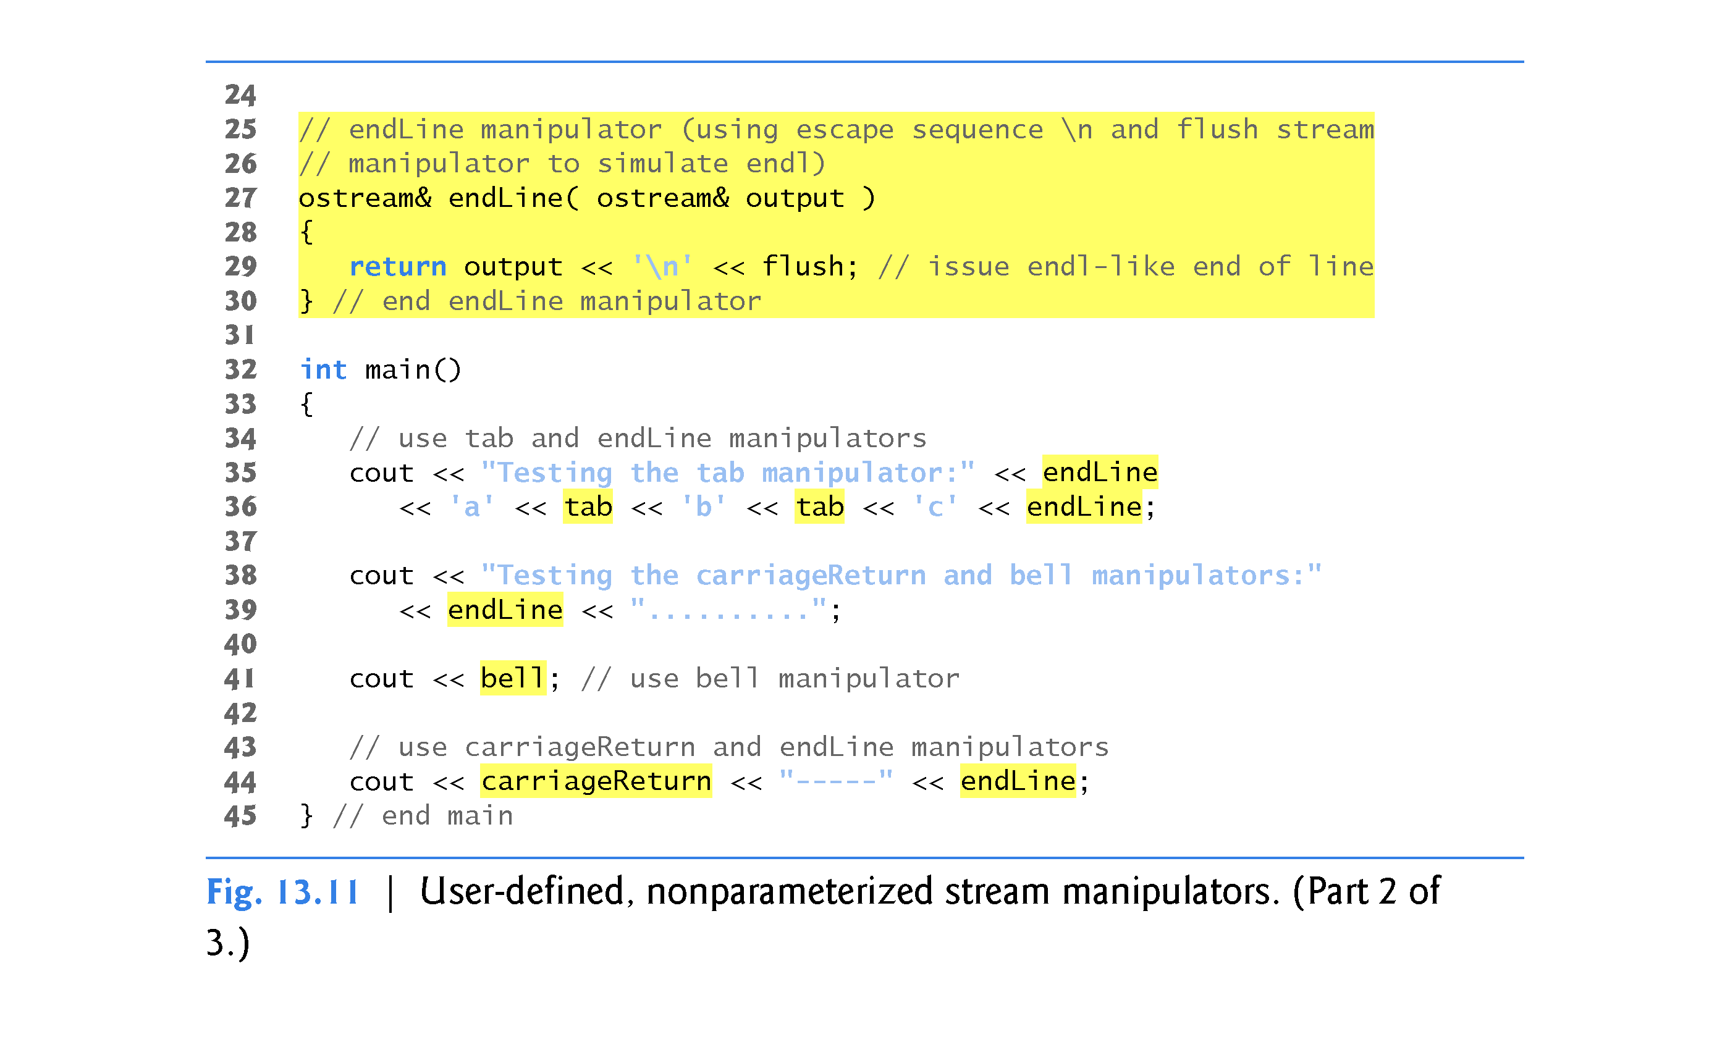

Slide 65
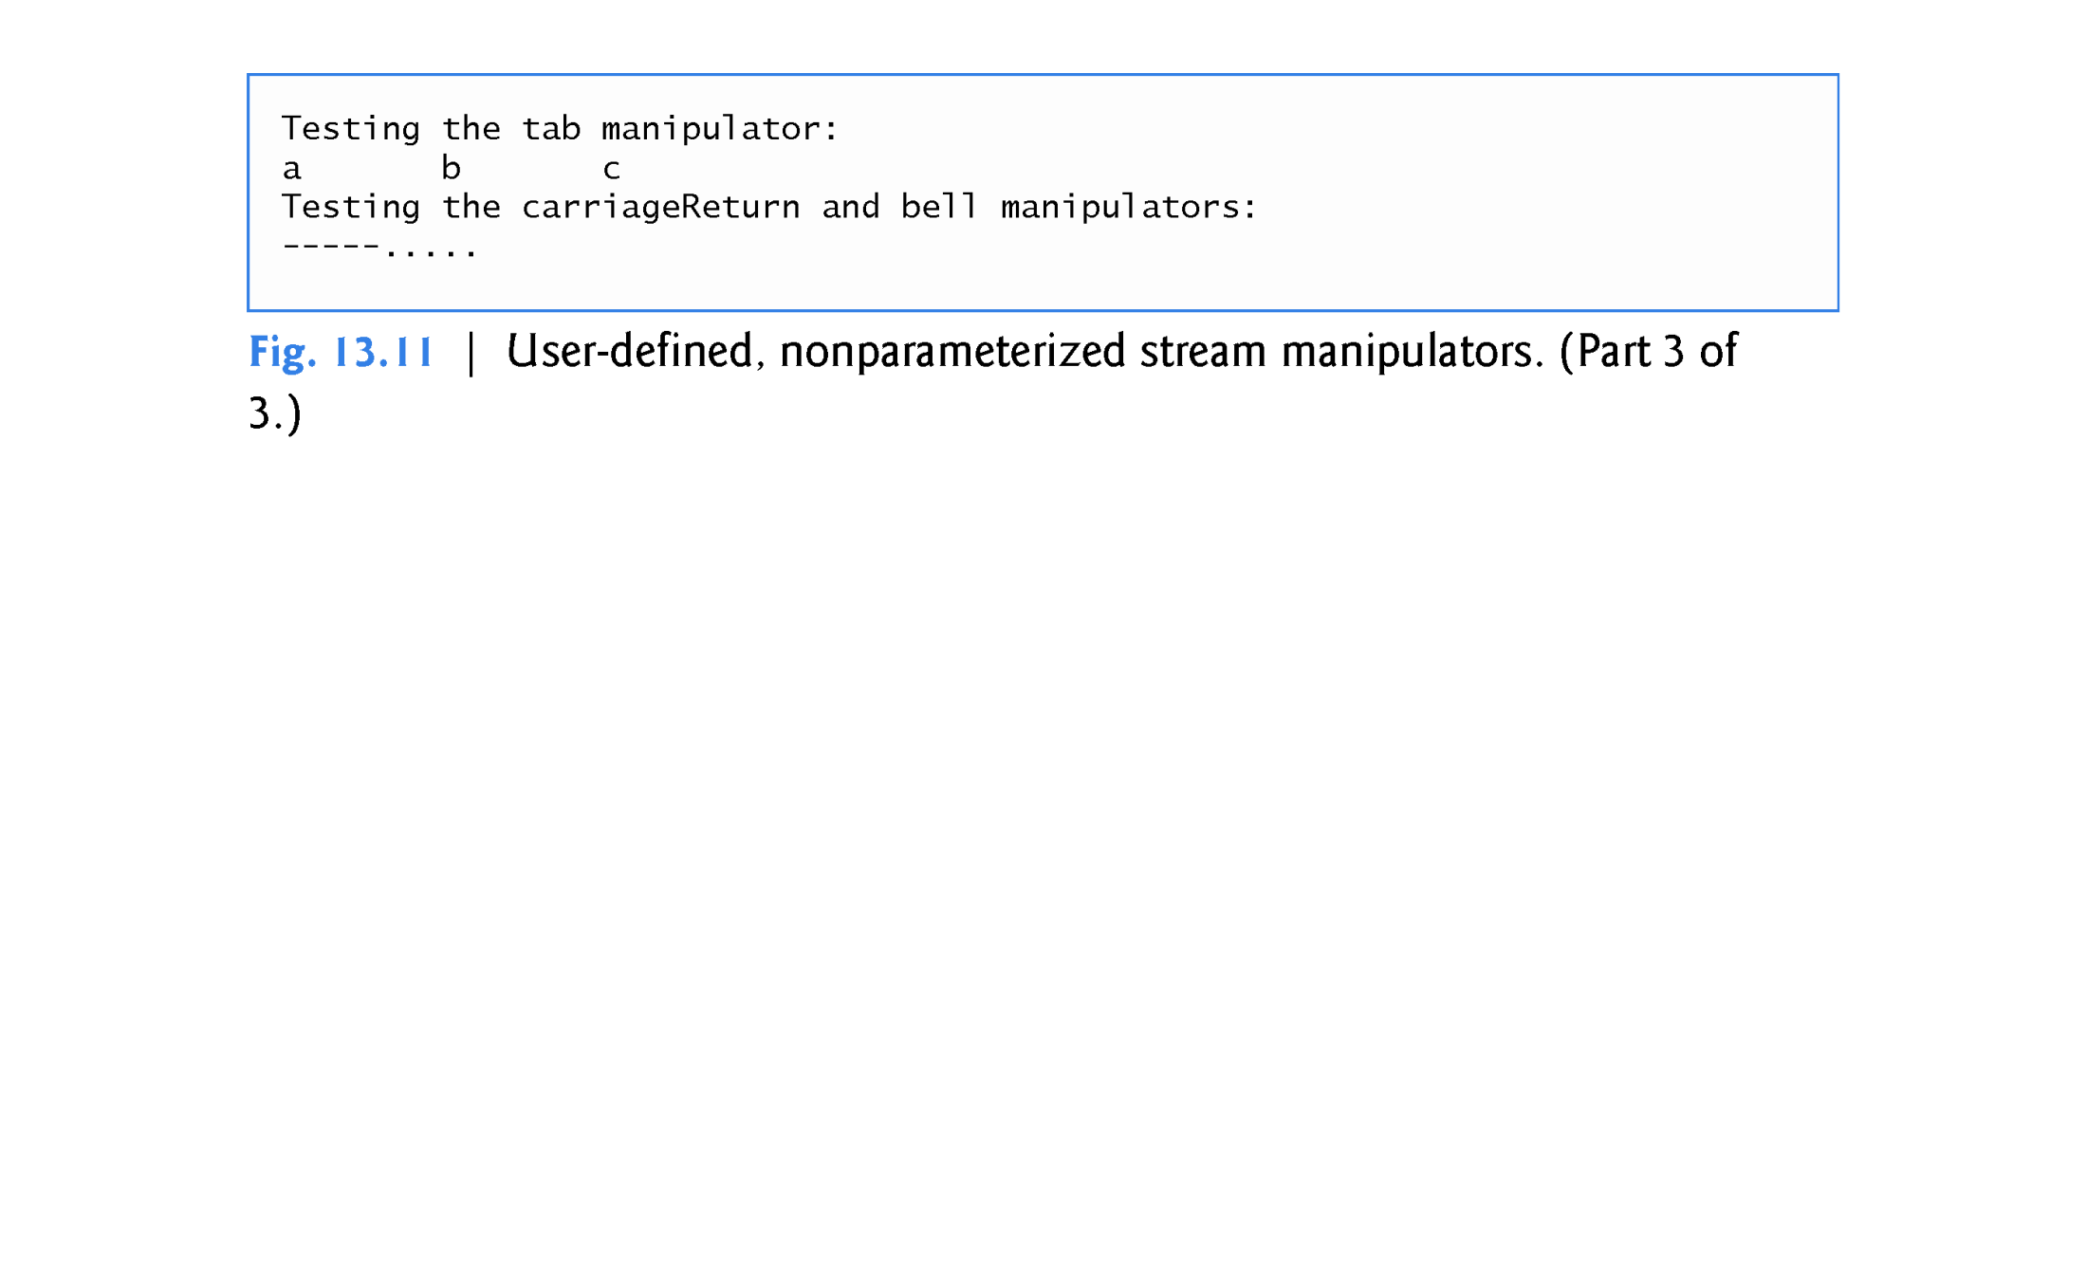

Slide 66
13.7 Stream Format States and Stream Manipulators
Various stream manipulators can be used to specify the kinds of formatting to be performed during stream-I/O operations.
Stream manipulators control the output’s format settings.
Figure 13.12 lists each stream manipulator that controls a given stream’s format state.
All these manipulators belong to class ios_base.
We show examples of most of these stream manipulators in the next several sections.

Slide 67
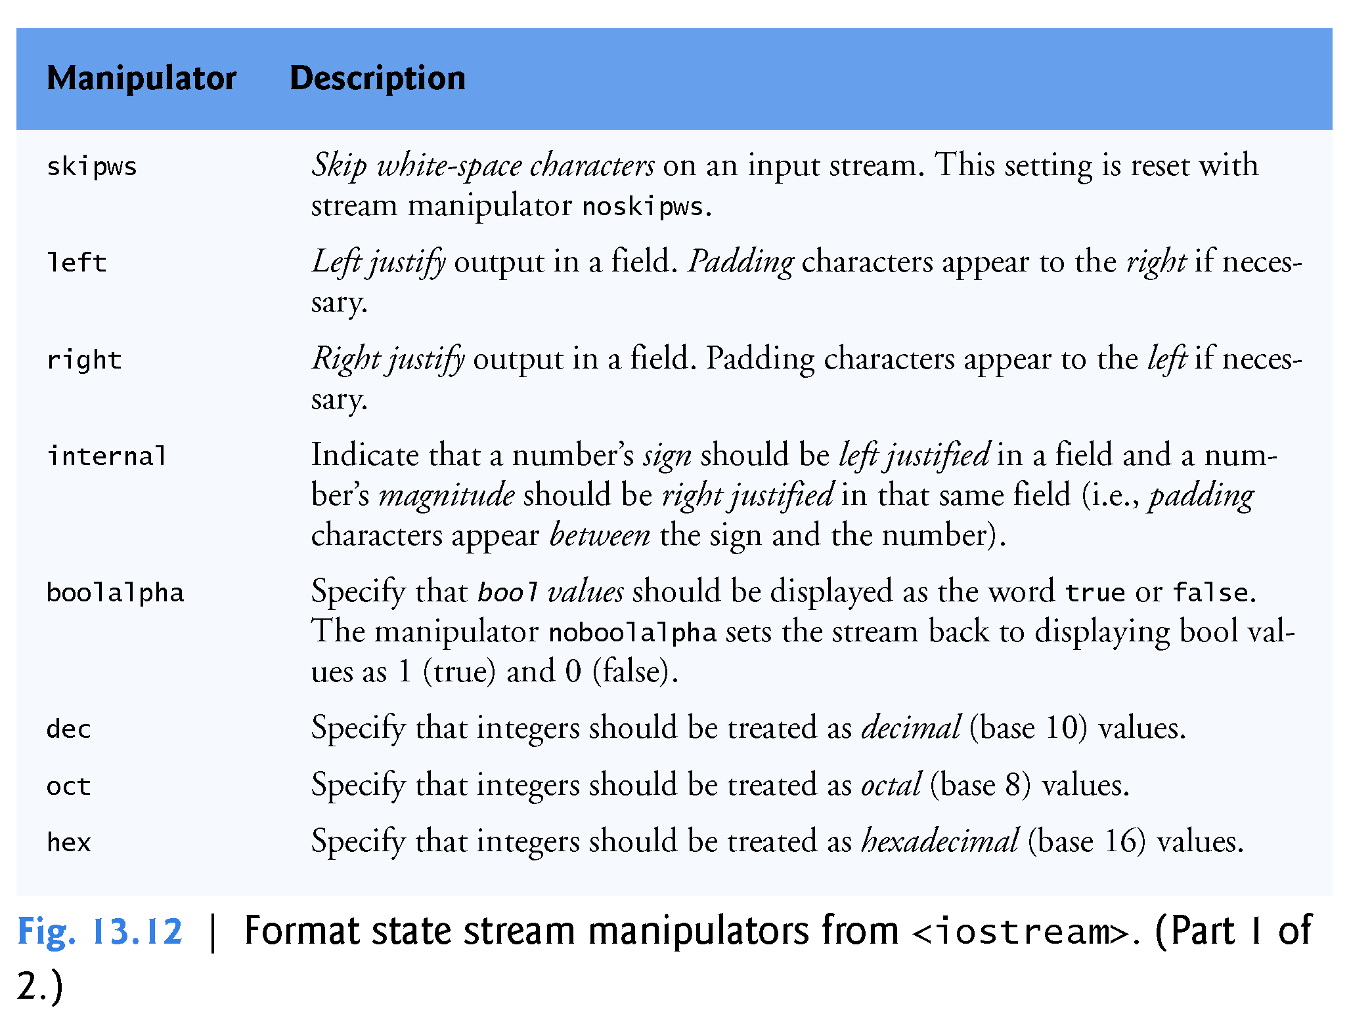

Slide 68
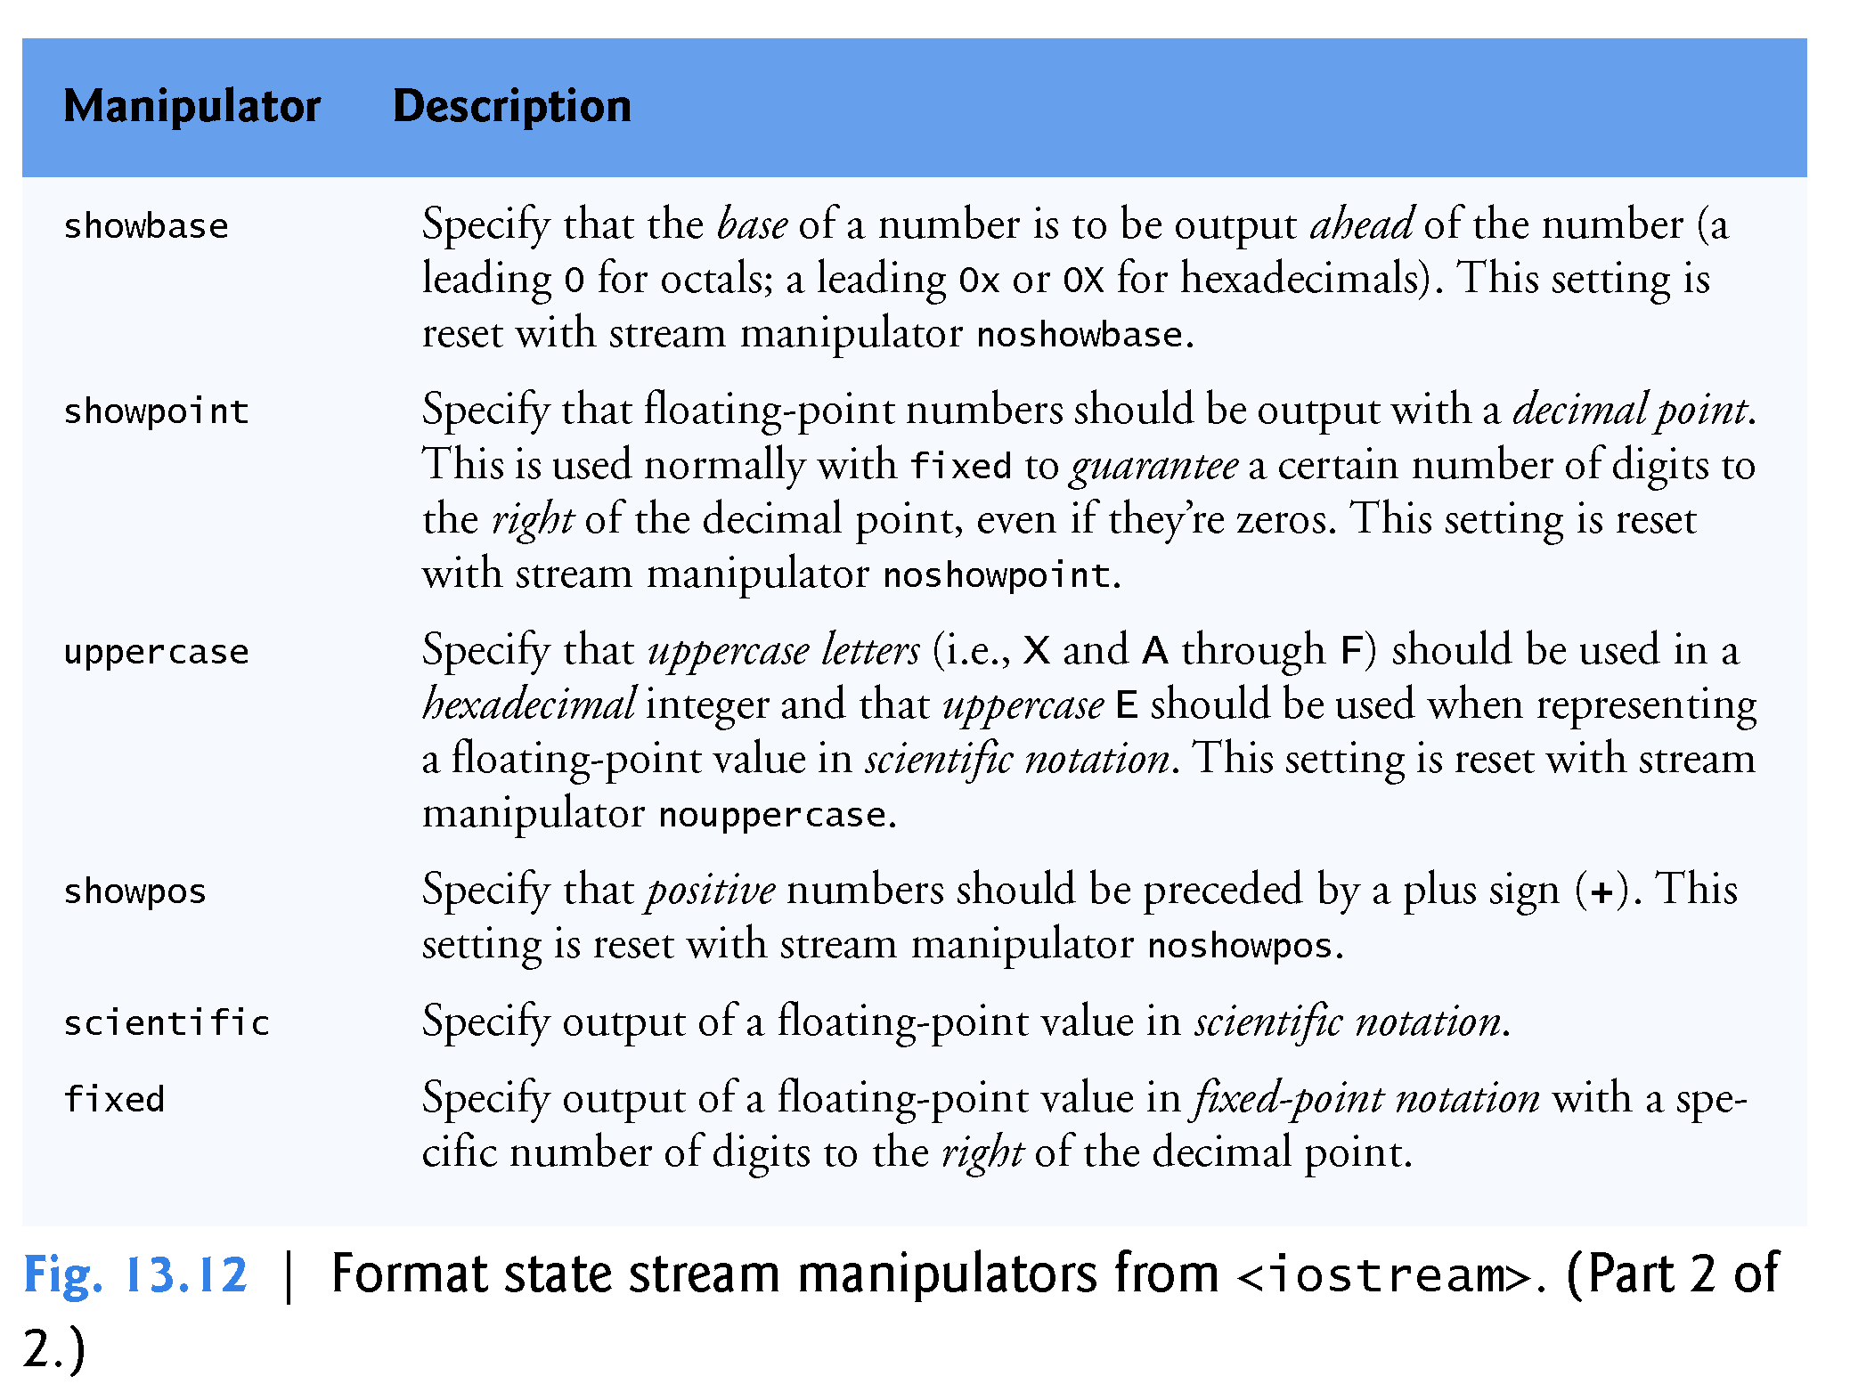

Slide 69
13.7.1 Trailing Zeros and Decimal Points (showpoint)
Stream manipulator showpoint is a sticky setting that forces a floating-point number to be output with its decimal point and trailing zeros.
To reset the showpoint setting, output the stream manipulator noshowpoint.
The program in Fig. 13.13 shows how to use stream manipulator showpoint to control the printing of trailing zeros and decimal points for floating-point values.
Recall that the default precision of a floating-point number is 6.
When neither the fixed nor the scientific stream manipulator is used, the precision represents the number of significant digits to display (i.e., the total number of digits to display), not the number of digits to display after decimal point.

Slide 70


Slide 71


Slide 72
13.7.2 Justification (left, right and internal)
Stream manipulators left and right enable fields to be left justified with padding characters to the right or right justified with padding characters to the left, respectively.
The padding character is specified by the fill member function or the setfill parameterized stream manipulator (which we discuss in Section 13.7.3).
Figure 13.14 uses the setw, left and right manipulators to left justify and right justify integer data in a field.

Slide 73
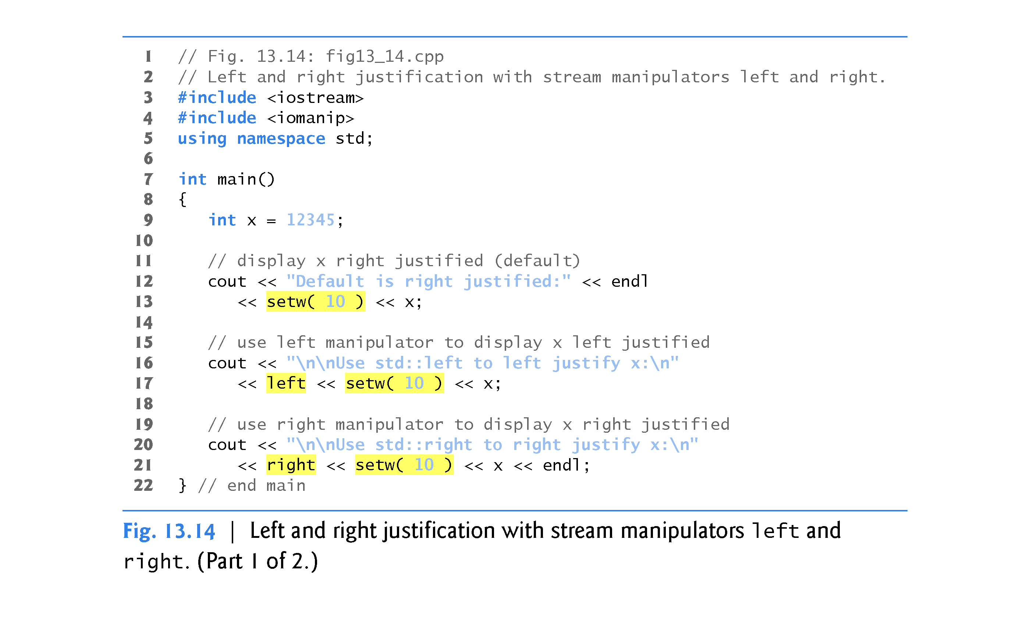

Slide 74
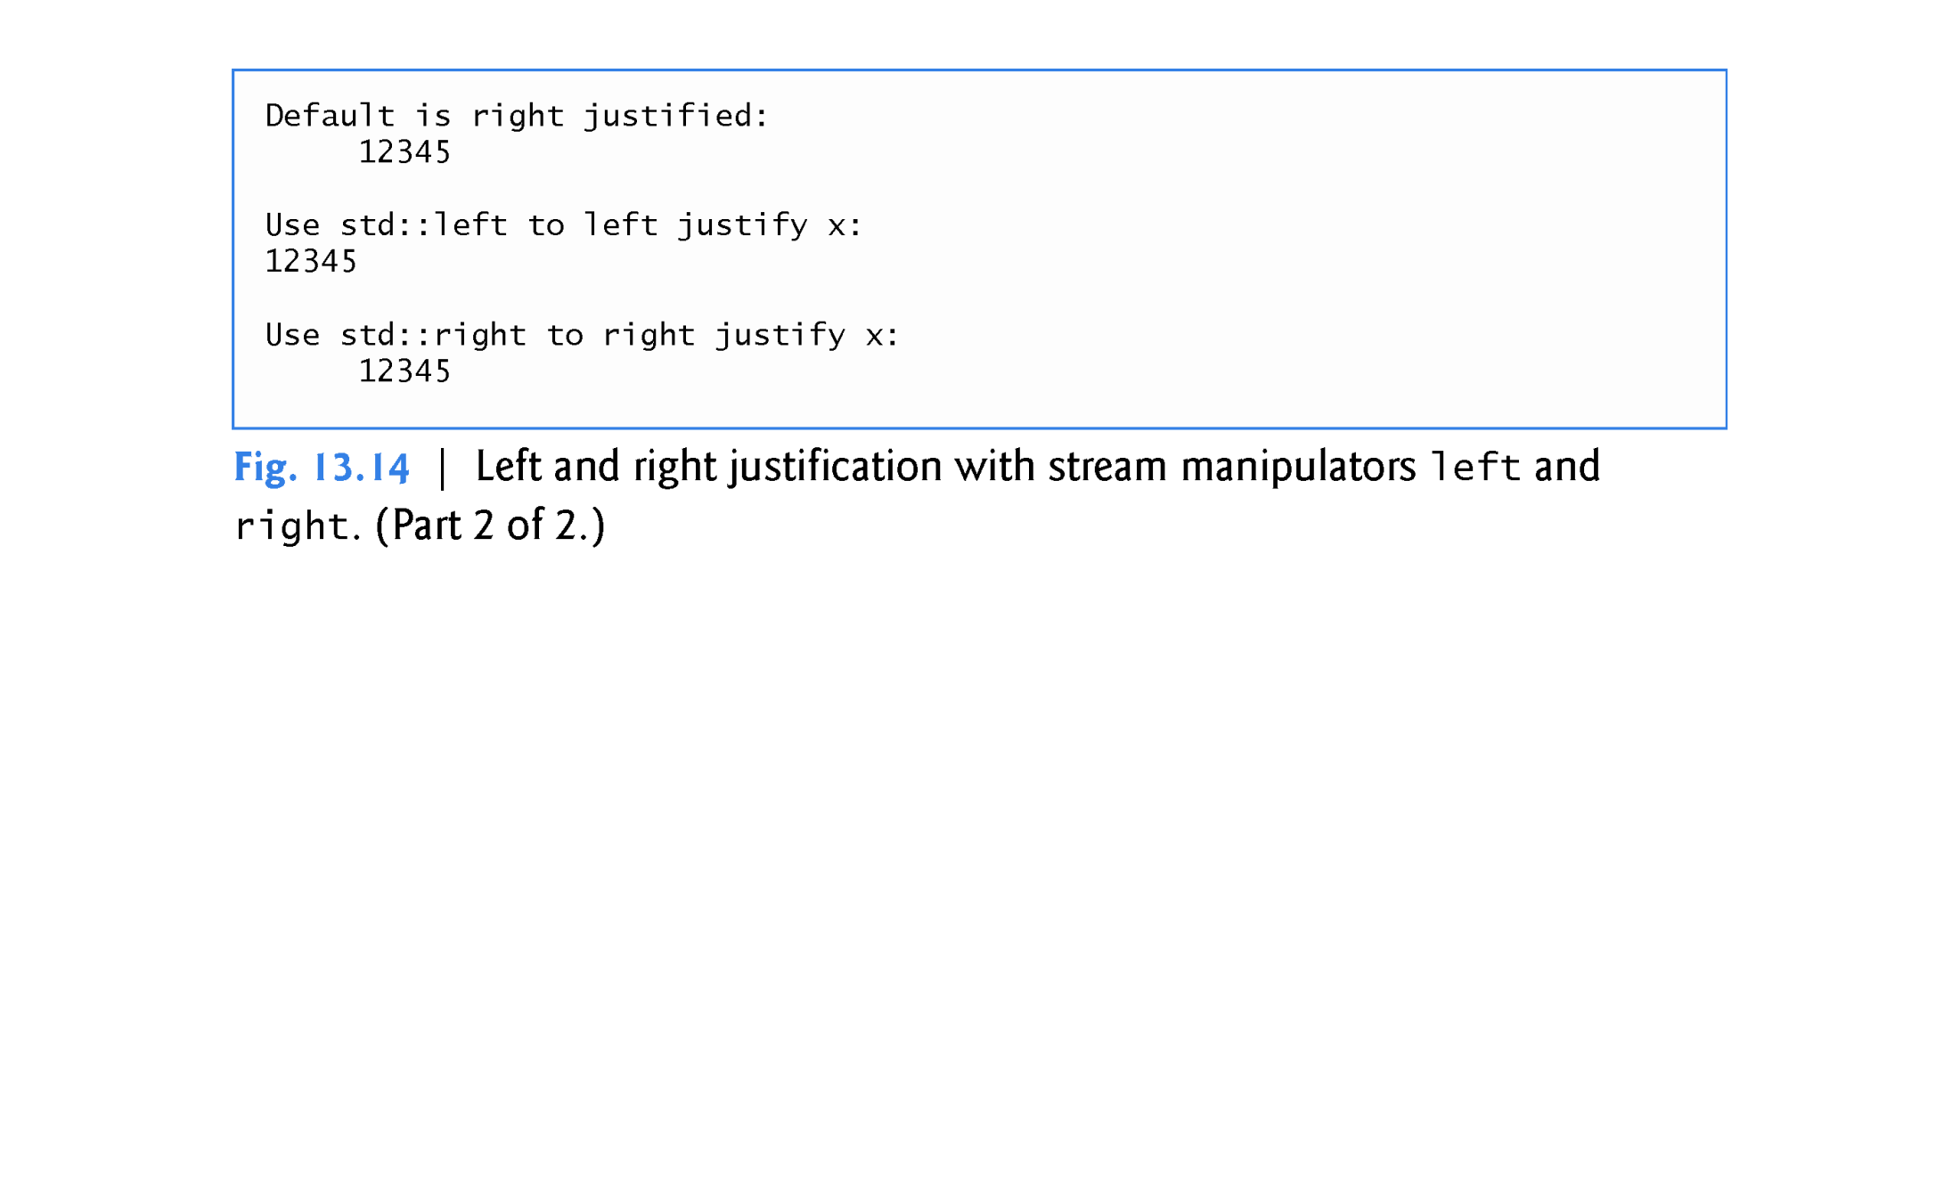

Slide 75
13.7.2 Justification (left, right and internal)
Stream manipulator internal indicates that a number’s sign (or base when using stream manipulator showbase) should be left justified within a field, that the number’s magnitude should be right justified and that intervening spaces should be padded with the fill character.
Figure 13.15 shows the internal stream manipulator specifying internal spacing (line 10).
Note that showpos forces the plus sign to print (line 10).
To reset the showpos setting, output the stream manipulator noshowpos.

Slide 76
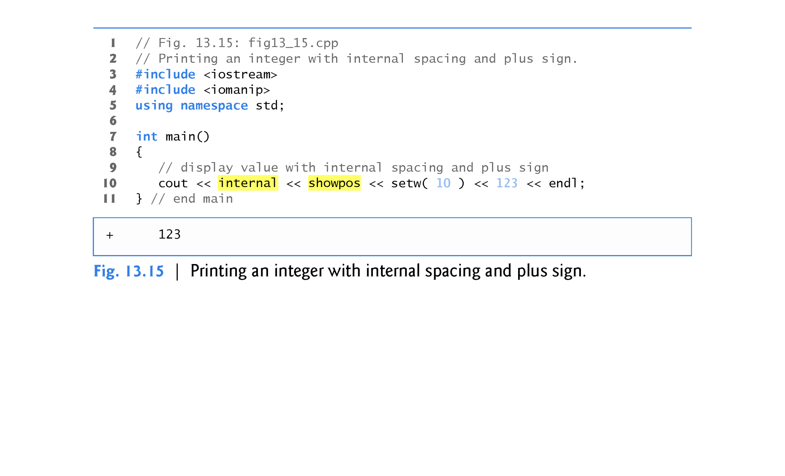

Slide 77
13.7.3 Padding (fill, setfill)
The fill member function specifies the fill character to be used with justified fields; spaces are used for padding by default.
The function returns the prior padding character.
The setfill manipulator also sets the padding character.
Figure 13.16 demonstrates function fill (line 30) and stream manipulator setfill (lines 34 and 37) to set the fill character.

Slide 78
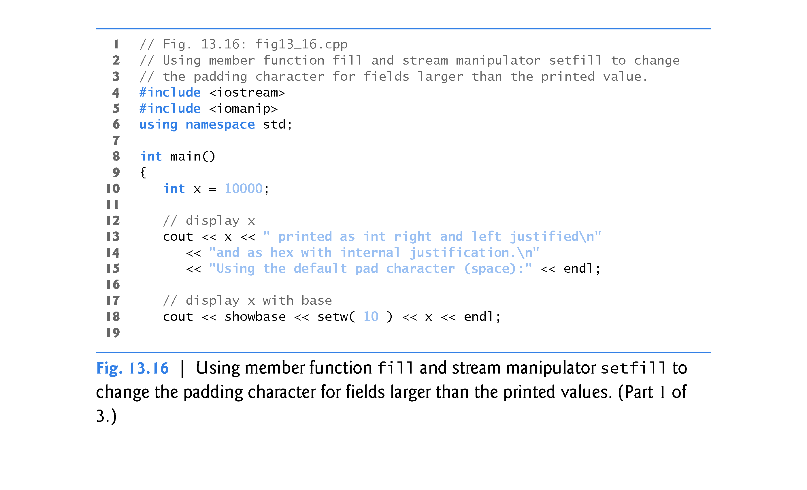

Slide 79
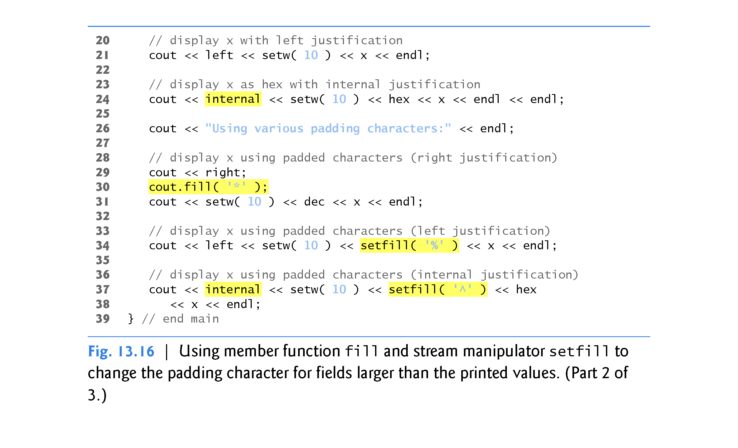

Slide 80
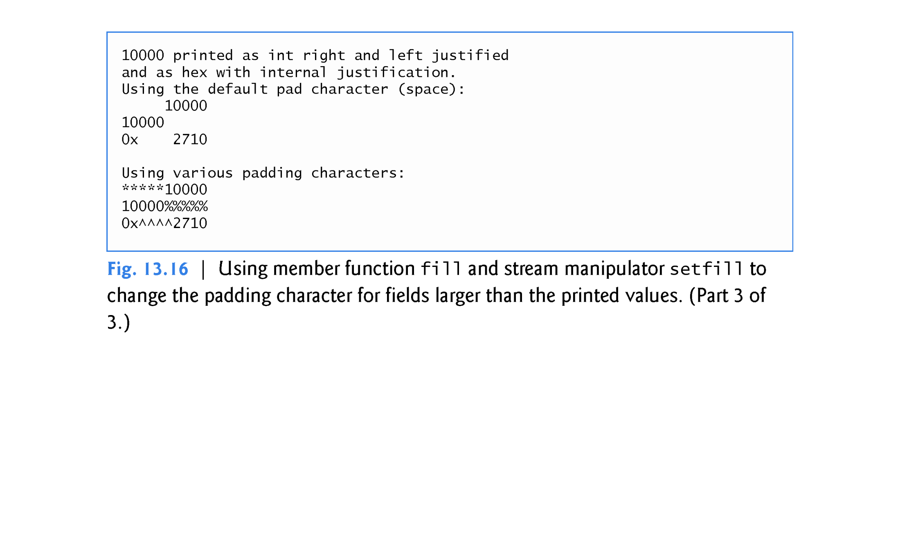

Slide 81
13.7.4 Integral Stream Base (dec, oct, hex, showbase)
C++ provides stream manipulators dec, hex and oct to specify that integers are to be displayed as decimal, hexadecimal and octal values, respectively.
Stream insertions default to decimal if none of these manipulators is used.
With stream extraction, integers prefixed with 0 (zero) are treated as octal values, integers prefixed with 0x or 0X are treated as hexadecimal values, and all other integers are treated as decimal values.
Once a particular base is specified for a stream, all integers on that stream are processed using that base until a different base is specified or until the program terminates.
Stream manipulator showbase forces the base of an integral value to be output.
Decimal numbers are output by default, octal numbers are output with a leading 0, and hexadecimal numbers are output with either a leading 0x or a leading 0X.

Slide 82
13.7.4 Integral Stream Base (dec, oct, hex, showbase)
Figure 13.17 demonstrates the use of stream manipulator showbase to force an integer to print in decimal, octal and hexadecimal formats.
To reset the showbase setting, output the stream manipulator noshowbase.

Slide 83
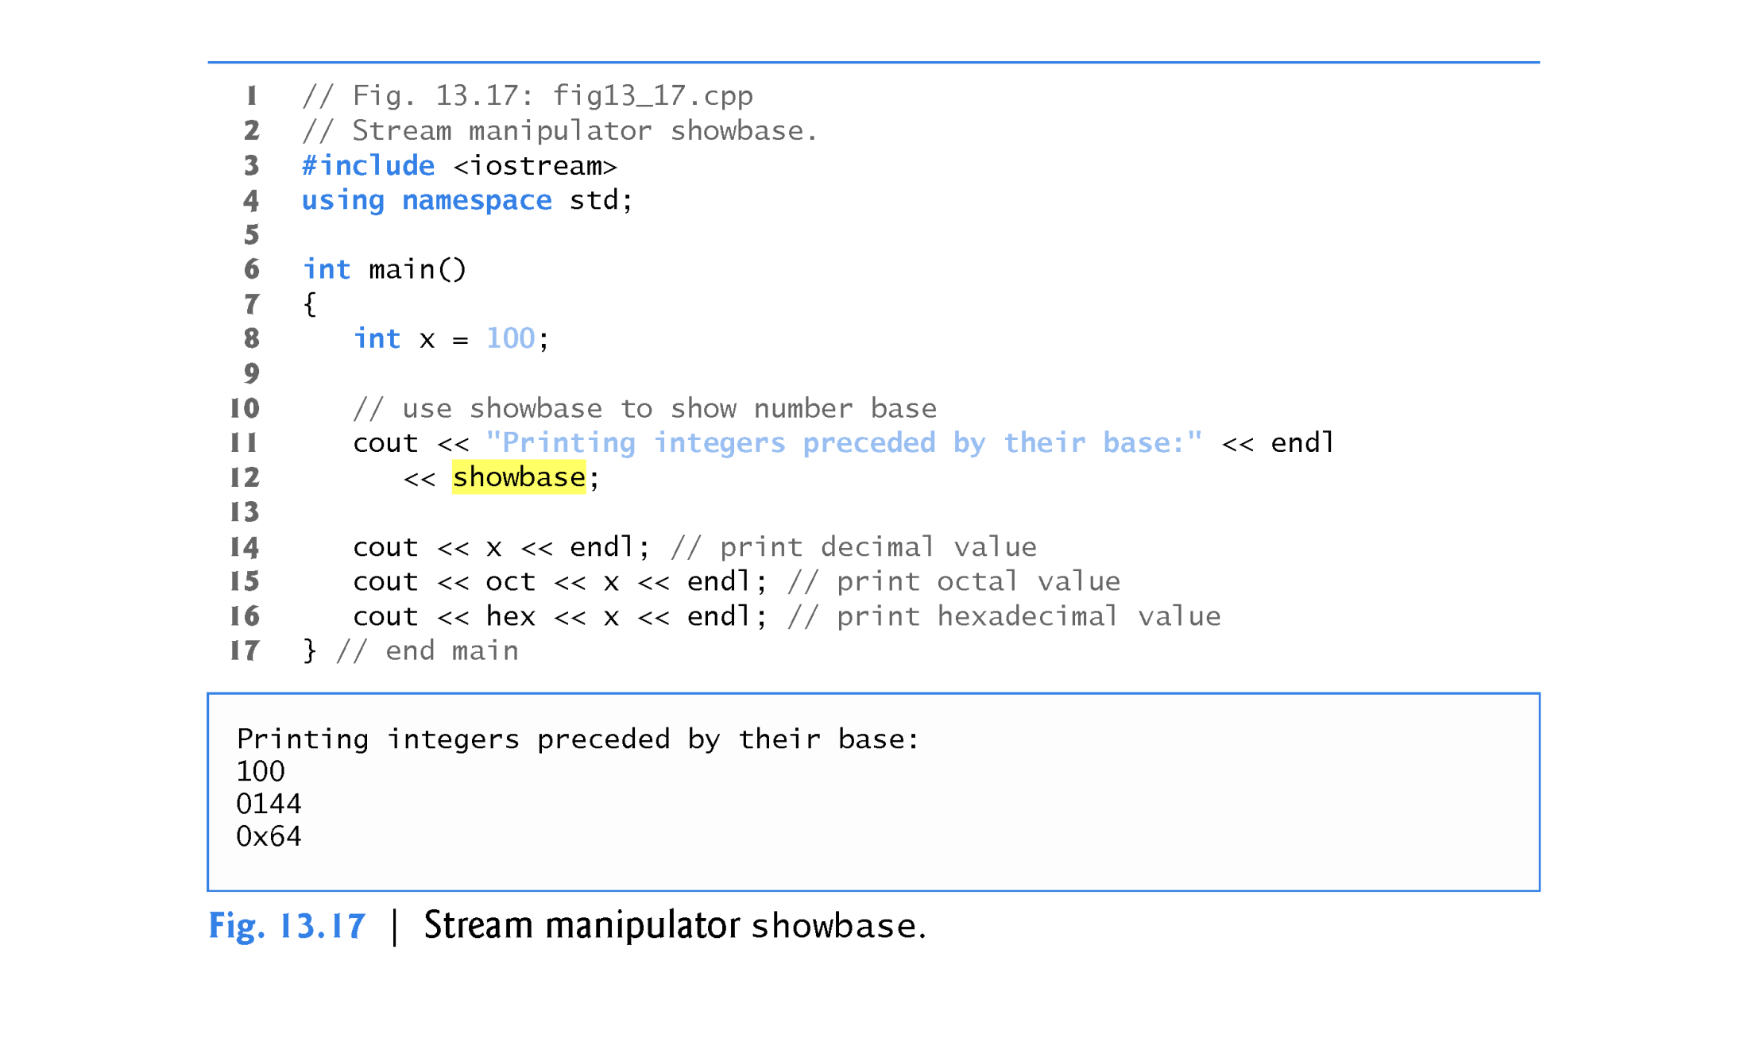

Slide 84
13.7.5 Floating-Point Numbers; Scientific and Fixed Notation (scientific, fixed)
The sticky stream manipulators scientific and fixed control the output format of floating-point numbers.
Stream manipulator scientific forces the output of a floating-point number to display in scientific format.
Stream manipulator fixed forces a floating-point number to display a specific number of digits (as specified by member function precision or stream manipulator setprecision) to the right of the decimal point.
Without using another manipulator, the floating-point number value determines the output format.
Figure 13.18 demonstrates displaying floating-point numbers in fixed and scientific formats using stream manipulators scientific (line 18) and fixed (line 22).

Slide 85
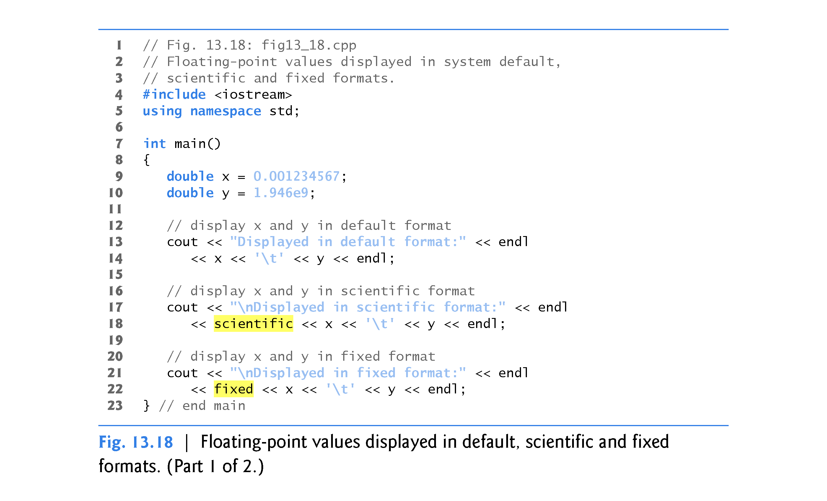

Slide 86
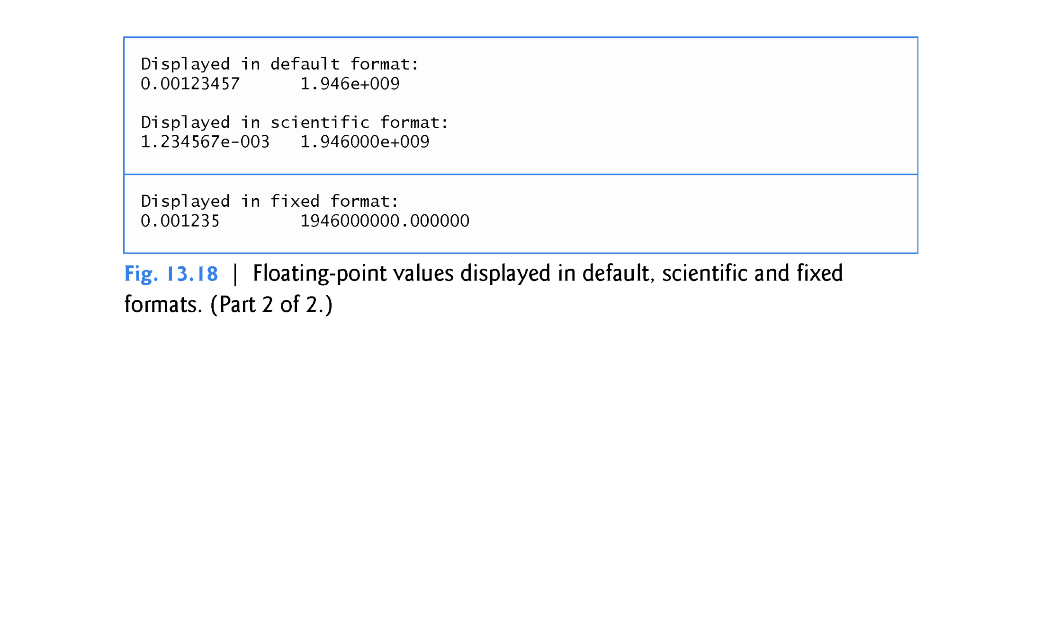

Slide 87
13.7.6 Uppercase/Lowercase Control (uppercase)
Stream manipulator uppercase outputs an uppercase X or E with hexadecimal-integer values or with scientific notation floating-point values, respectively (Fig. 13.19).
Using stream manipulator uppercase also causes all letters in a hexadecimal value to be uppercase.
By default, the letters for hexadecimal values and the exponents in scientific notation floating-point values appear in lowercase.
To reset the uppercase setting, output the stream manipulator nouppercase.

Slide 88
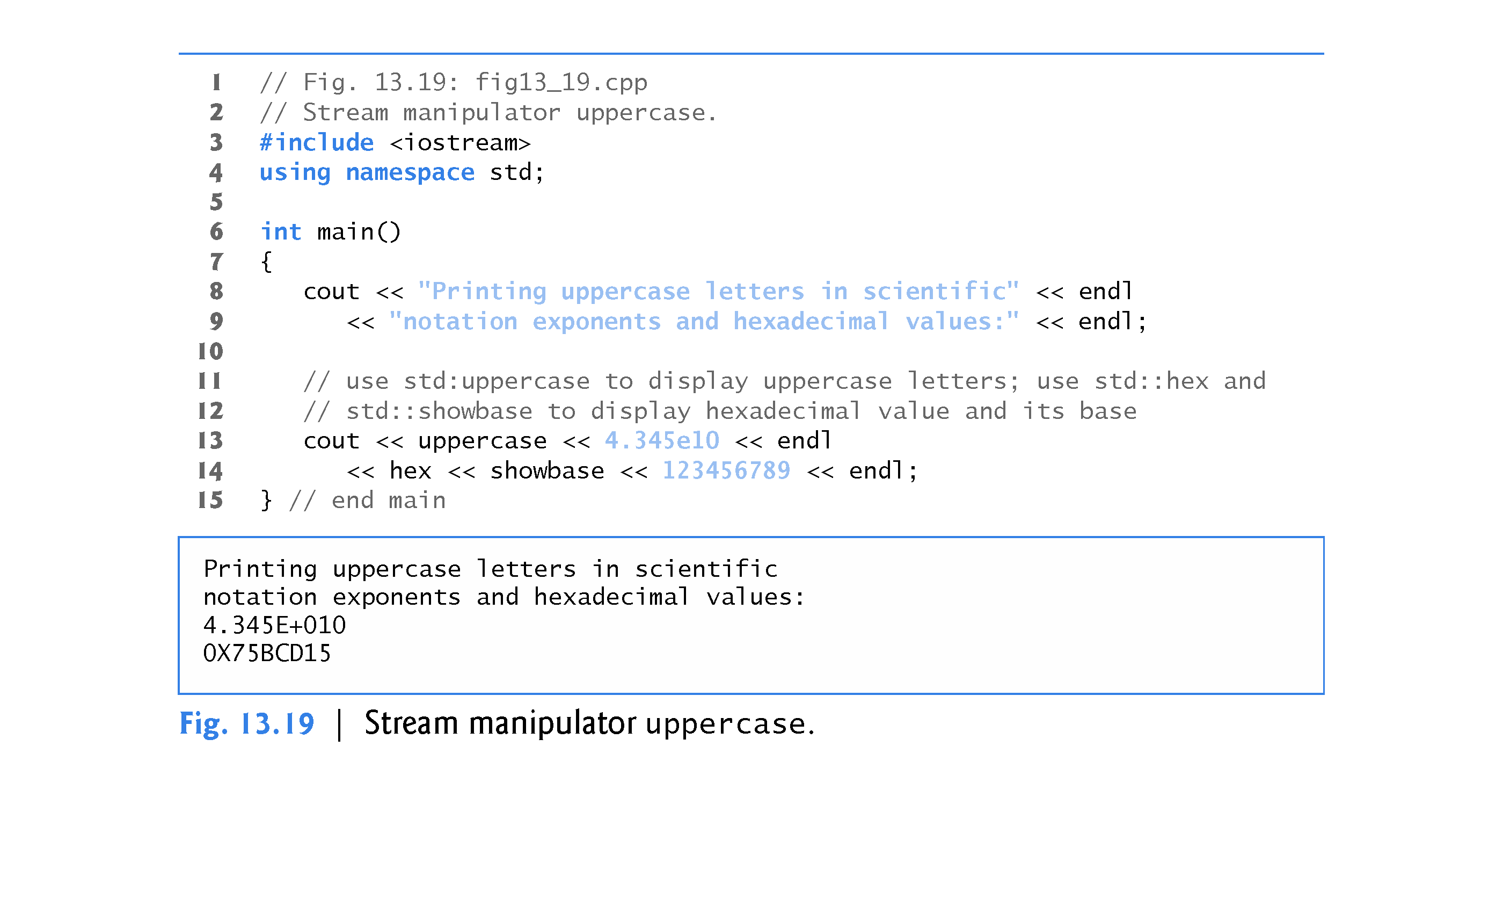

Slide 89
13.7.7 Specifying Boolean Format (boolalpha)
C++ provides data type bool, whose values may be false or true, as a preferred alternative to the old style of using 0 to indicate false and nonzero to indicate true.
A bool variable outputs as 0 or 1 by default.
However, we can use stream manipulator boolalpha to set the output stream to display bool values as the strings "true" and "false".
Use stream manipulator noboolalpha to set the output stream to display bool values as integers (i.e., the default setting).
The program of Fig. 13.20 demonstrates these stream manipulators.

Slide 90
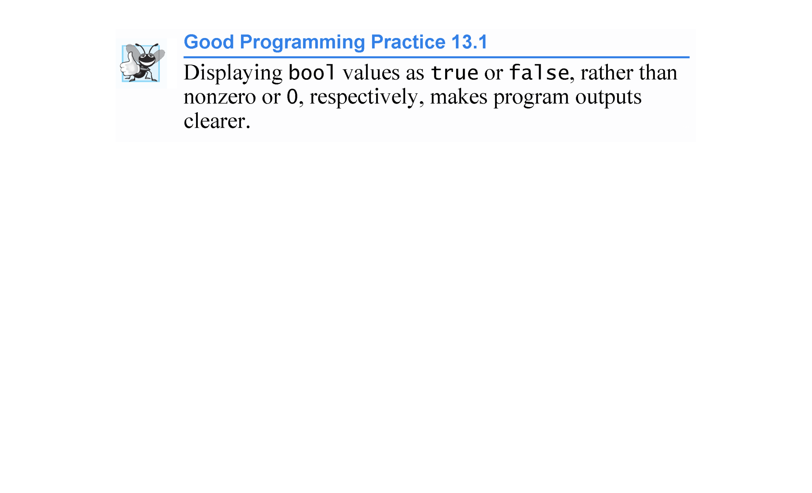

Slide 91
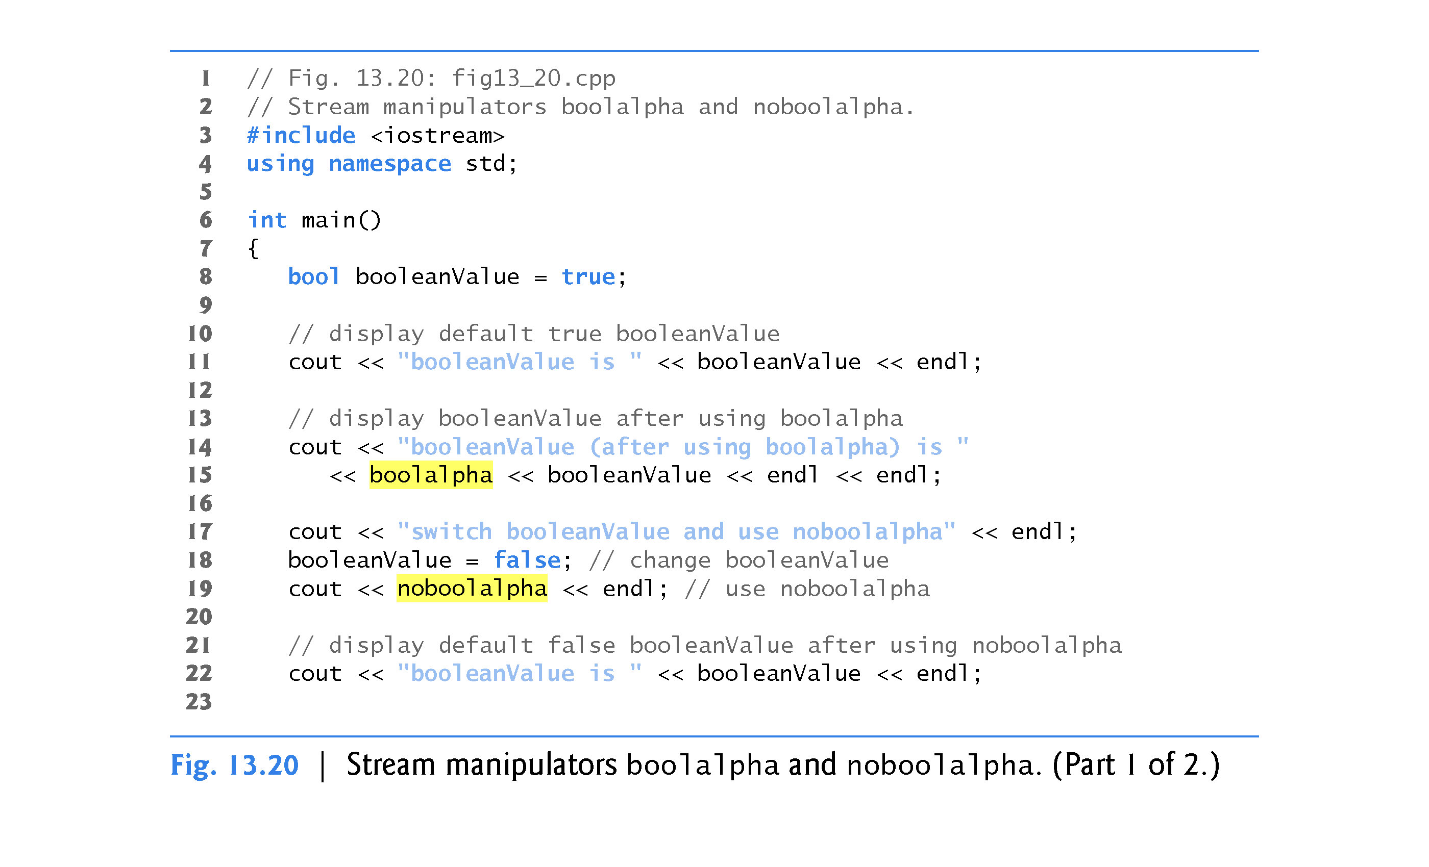
Does not require you to include the header iomanip

Slide 92
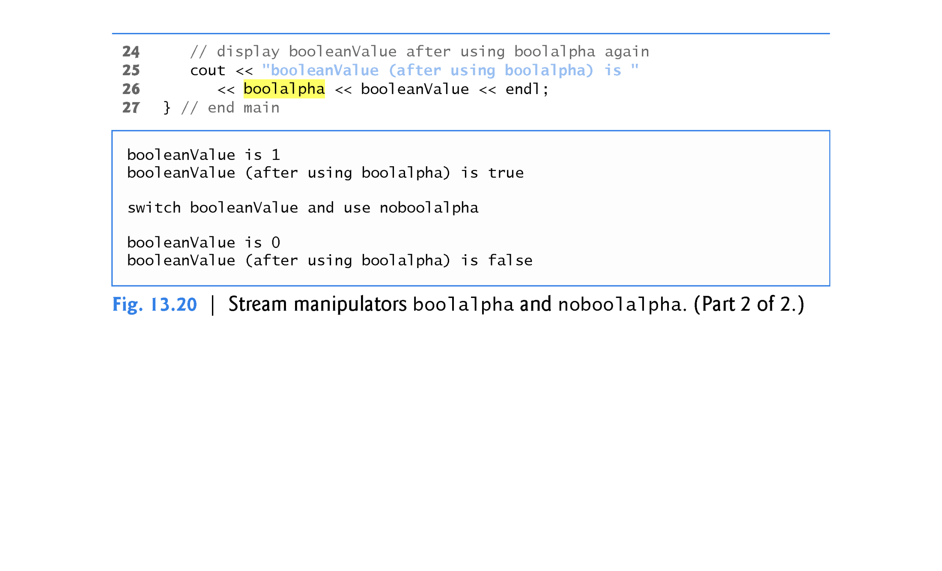

Slide 93
Member Functions and Stream Manipulators
Member Function Stream Manipulator
fill( ) setfill( )
precision( ) setprecision( )
width( ) setw( )

Slide 94
13.7.8 Setting and Resetting the Format State via Member Function flags
We now discuss how to return an output stream’s format to its default state after having applied several manipulations.
Member function flags without an argument returns the current format settings as a fmtflags data type (of class ios_base), which represents the format state.
Member function flags with a fmtflags argument sets the format state as specified by the argument and returns the prior state settings.
The initial settings of the value that flags returns might differ across several systems.
The program of Fig. 13.21 uses member function flags to save the stream’s original format state (line 17), then restore the original format settings (line 25).

Slide 95
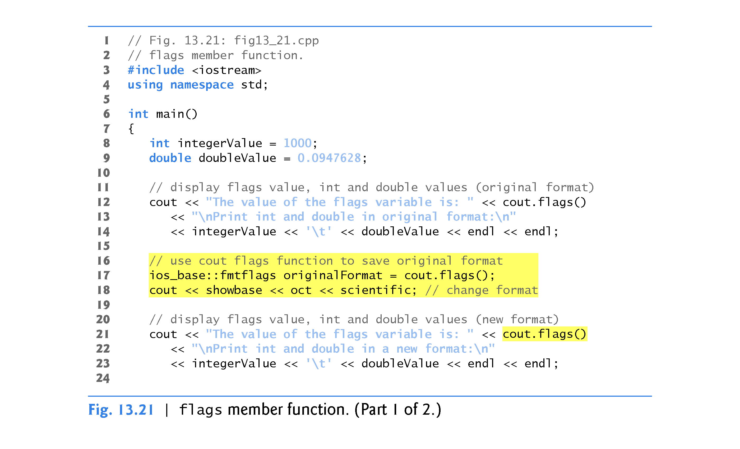

Slide 96
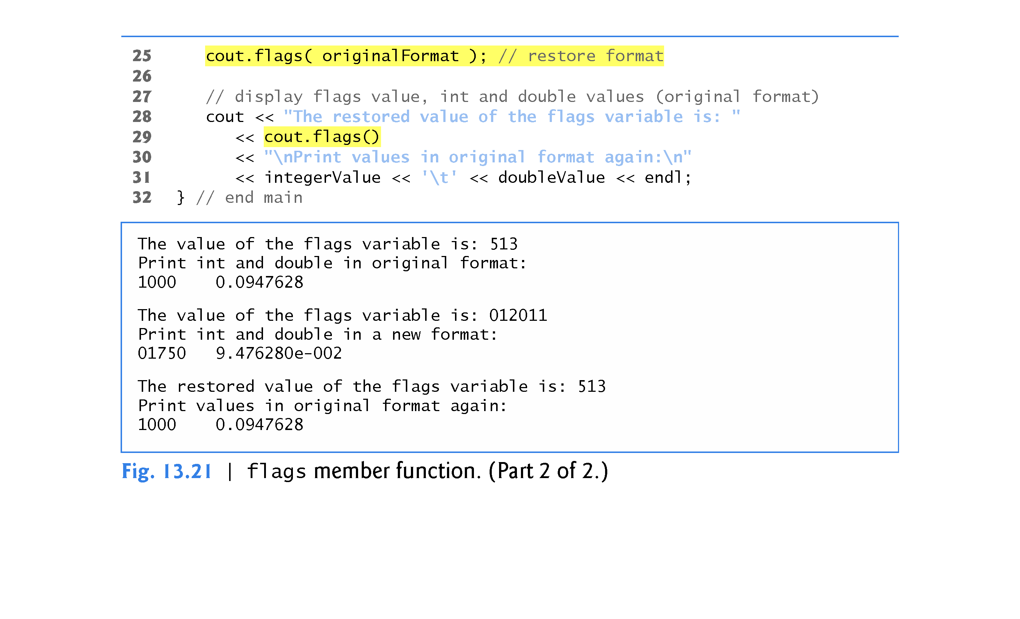

Slide 97
1 // setiosflags example
// setiosflags is a stream manipulator
2 #include <iostream> // cout, hex, endl 3 #include <iomanip> // setiosflags 4 using namespace std; 5 6 int main () { 7 cout << hex; 8 cout << setiosflags (std::ios::showbase | std::ios::uppercase); 9 cout << 100 << endl; 10 11 return 0; 12 }
//------------------------------------------------------------
Output: 0X64
//Note: There is also a resetiosflags stream manipulator to reset
stream manipulators to default values

Slide 98
1 // modifying flags with cout setf/unsetf member functions
2 #include <iostream> // cout, std::ios 3 #include <iomanip> 4 using namespace std; 5 6 int main () { 7 cout.setf ( std::ios::hex, std::ios::basefield ); // set hex as the basefield 8 cout.setf ( std::ios::showbase ); // activate showbase 9 cout << setw(5) << 100 << " " << setw(5) << 25 << '\n'; 10 11 cout.unsetf ( std::ios::showbase ); // deactivate showbase 12 13 cout << setw(5) << 100 << " " << setw(5) << 25 << "\n\n"; 14 15 cout.unsetf ( std::ios::basefield); 16 17 cout << setw(5) << 100 << " " << setw(5) << 25 << '\n'; 18 19 return 0; 20 }
//----------------------------------------------------------------------------------
Output: 0x64 0x19 64 19
100 25

Slide 99
13.8 Stream Error States
The state of a stream may be tested through bits in class ios_base.
Figure 13.22 shows how to test these state bits.

Slide 100
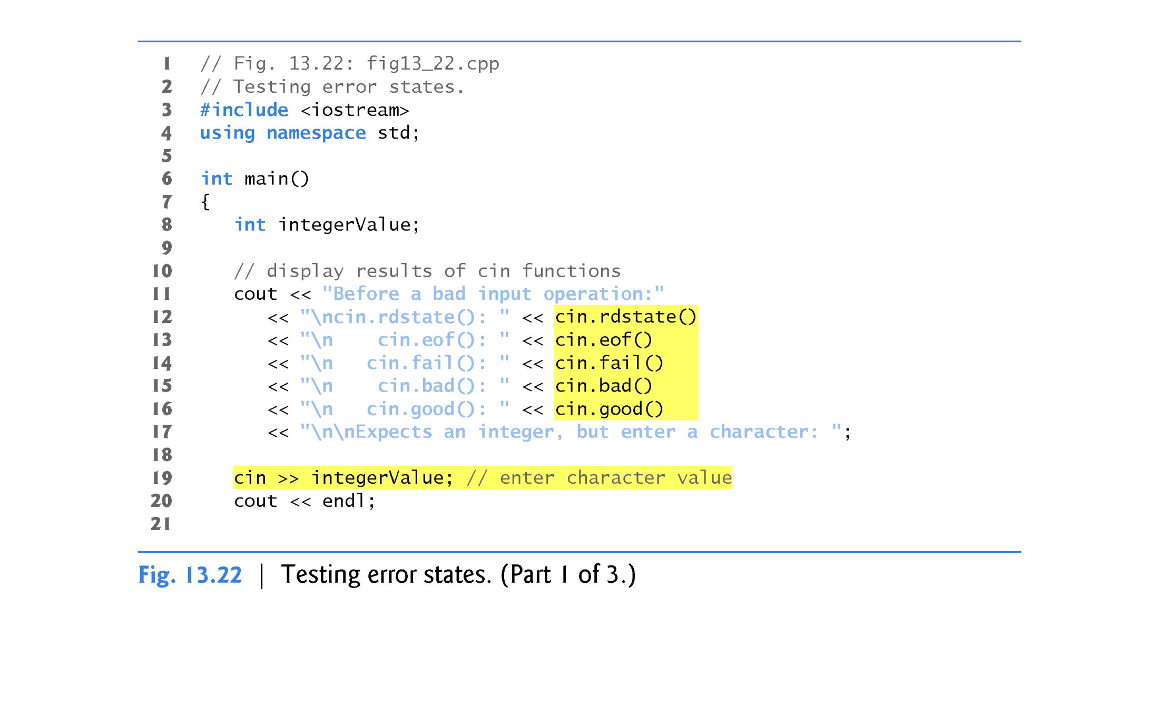

Slide 101
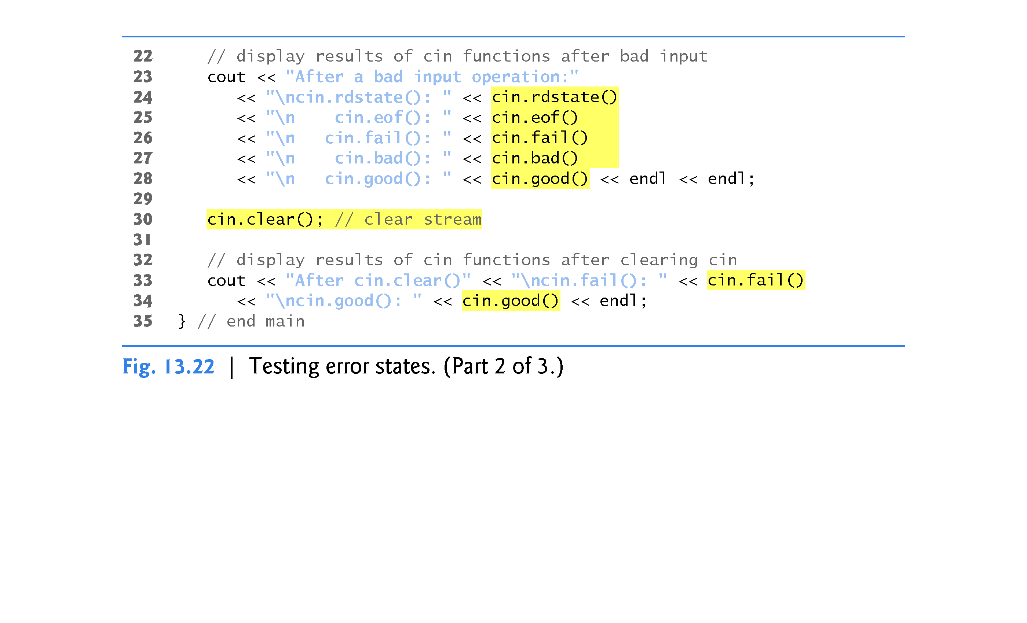

Slide 102
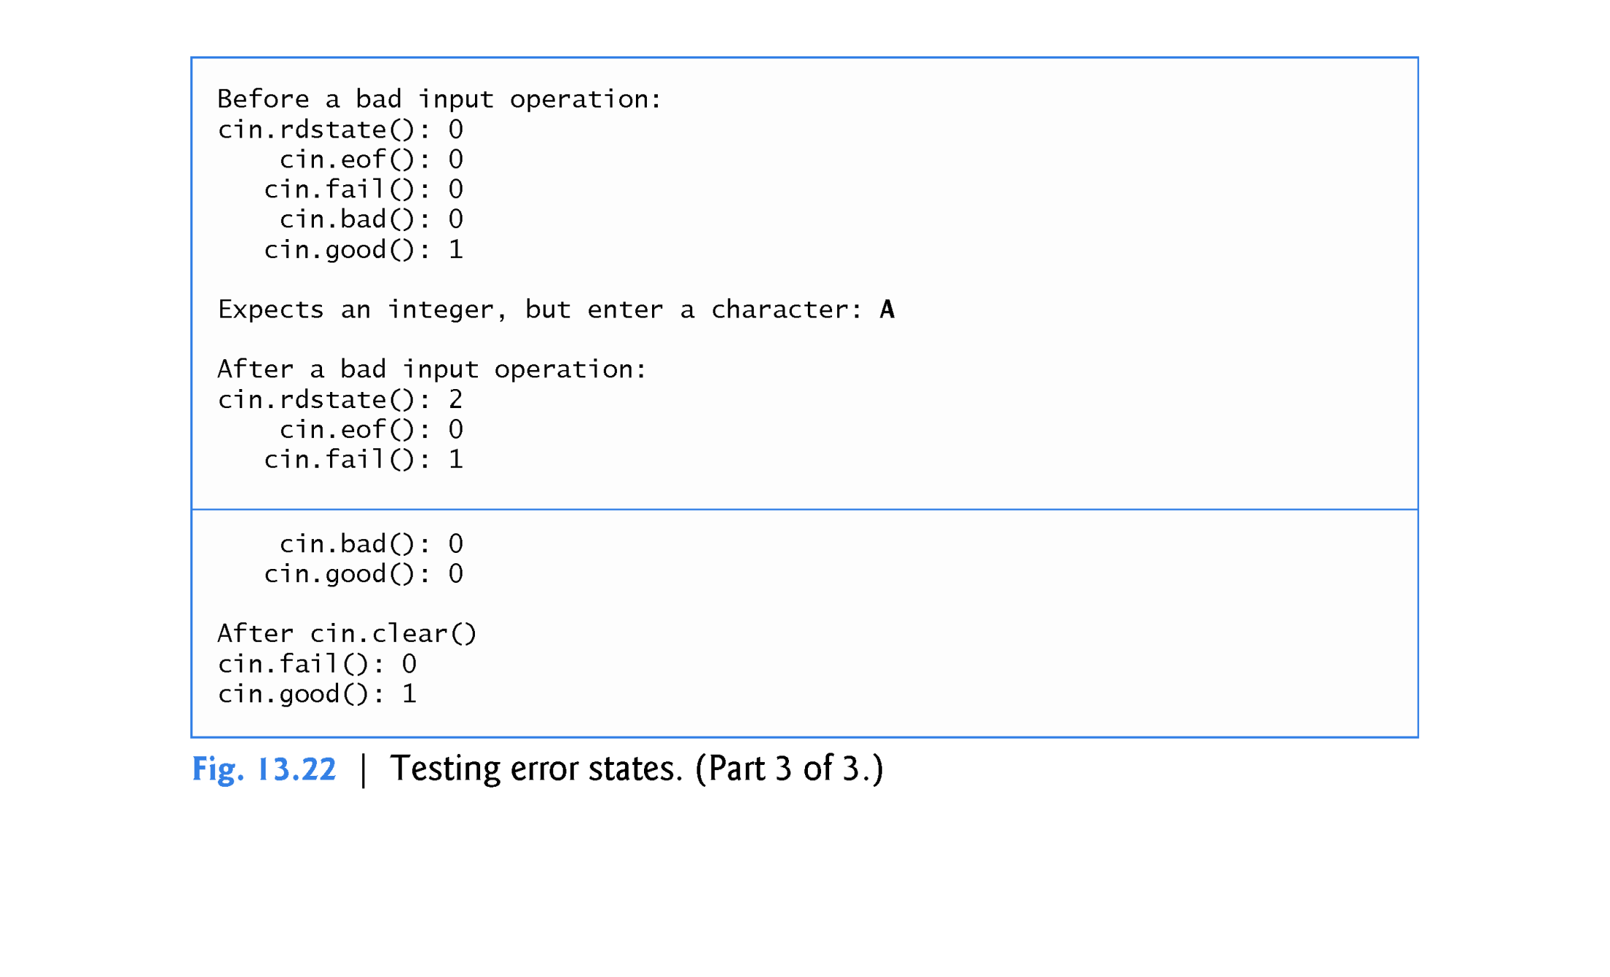

Slide 103
13.8 Stream Error States (cont.)
The eofbit is set for an input stream after end-of-file is encountered.
For interactive input
EOF (ctrl-z/ctrl-d) causes both the eofbit and the failbit to be set.
For file input
EOF condition causes only the eofbit to be set.

Slide 104
13.8 Stream Error States (cont.)
The failbit is set for a stream when a format error occurs on the stream and no characters are input (e.g., when you attempt to read a number and the user enters a string).
When such an error occurs, the characters are not lost.
The fail member function reports whether a stream operation has failed.
Usually, recovering from such errors is possible.
Use the clear() and ignore() functions to reset the stream state.

Slide 105
13.8 Stream Error States (cont.)
The badbit is set for a stream when an error occurs that results in the loss of data.
The bad member function reports whether a stream operation failed.
Generally, such serious failures are nonrecoverable.
The goodbit is set for a stream if none of the bits eofbit, failbit or badbit is set for the stream.
The good member function returns true if the bad, fail and eof functions would all return false.
I/O operations should be performed only on “good” streams.
The rdstate member function returns the stream’s error state.
The preferred means of testing the state of a stream is to use member functions eof, bad, fail and good—using these functions does not require you to be familiar with particular status bits.
The clear member function is used to restore a stream’s state to “good,” so that I/O may proceed on that stream.

Slide 106
13.8 Stream Error States (cont.)
The program of Fig. 13.22 demonstrates member functions rdstate, eof, fail, bad, good and clear.
The operator! member function of basic_ios returns true if the badbit is set, the failbit is set or both are set.
The operator void * member function returns false (0) if the badbit is set, the failbit is set or both are set.
These functions are useful in file processing when a true/false condition is being tested under the control of a selection statement or repetition statement.

Slide 107
13.9 Tying an Output Stream to an Input Stream
Interactive applications generally involve an istream for input and an ostream for output.
When a prompting message appears on the screen, the user responds by entering the appropriate data.
Obviously, the prompt needs to appear before the input operation proceeds.
With output buffering, outputs appear only when the buffer fills, when outputs are flushed explicitly by the program or automatically at the end of the program.
C++ provides a member function tie to synchronize (i.e., “tie together”) the operation of an istream and an ostream to ensure that outputs appear before their subsequent inputs.
The call
cin.tie( &cout );
ties cout (an ostream) to cin (an istream).
Removes need to use flush() or endl to flush the buffer

